Slide 1
Is Paul Real or Fake?

Slide 2
Note Well –
a. Because Paul was not a disciple of Jesus in His earthly ministry, he did not receive inspiration as other apostles did – Jn.20:22
b. Lord appointed 12 apostles, Mt.10:2 [not 13]. [Ac.1:21-26; Ac.13:1-3, Paul was an ‘apostle’ of churches, not of Lord]
c. Paul went to Gentiles, Gal.2:9. Thus, Paul may be a servant, a preacher, but he can’t be an apostle
– Judaizers
Conclusion: lies, lies, and more lies

Slide 3
No wonder: Paul’s first words to Galatians – Paul, an apostle; not just any apostle, but through Jesus Christ and God the Father…
Ordinarily at this point we would begin with an introduction to Galatians…

Slide 4
I. Paul, an Apostle, 1

Slide 5
Paul is an apostle [emphatic]
Despite objections of Judaizers
1. His authority derives from God, ⸫ to oppose him is to oppose God. Our society needs this warning. Many still reject Paul…
2. He answers Judaizers’ false charges. They are both wrong and lost.
3. He is Lord’s ambassador, speaking / writing with heavenly authority.

Slide 6
Paul is an apostle . . .
1. Not from men nor through man. [Cf. Isaiah 6]
Judaizers oppose / slander everyone they cannot answer
They are mere men with authority of mere men
Paul graduated with honors from school of Gamaliel – Ph.3:…7-8 (Ac.22:3)
He counted it all garbage when compared to salvation in Christ

Slide 7
Paul is an apostle . . .
2. But through Jesus Christ and the Father Who raised Him from the dead
Jesus could make Paul an apostle as He did the 12
The Godhead sent Paul
Jesus appeared to Paul more gloriously than He did to the twelve (Ac.9)

Slide 8
I. Paul, an Apostle, 1
II. Paul’s Brethren, 2

Slide 9
All the brethren who are with me…
Paul is not alone: other faithful brothers stand with him
Paul answers those who are bringing the Galatians into spiritual slavery
To the churches of Galatia…
North or South?

Slide 10
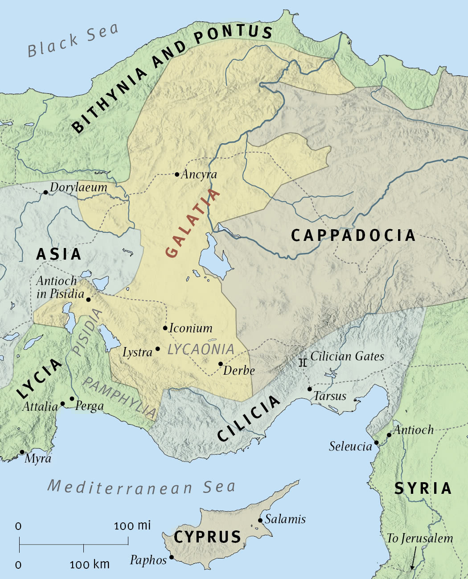
Acts 13-14

Slide 11
I. Paul, an Apostle, 1
II. Paul’s Brethren, 2
III. Paul’s Wish, 3

Slide 12
Grace to you and peace
Grace – anticipates v. 6; 5:4 – stay in it
Peace – ‘all is well.’ Paul’s wish: peace to Galatians. (6-9)
From God the Father and our Lord Jesus Christ
1. NB: Jesus is Author of grace / peace as is the Father.
2. These are heavenly blessings. Will Galatians forfeit them?

Slide 13
I. Paul, an Apostle, 1
II. Paul’s Brethren, 2
III. Paul’s Wish, 3
IV. Paul’s Gratitude to the Lord, 4

Slide 14
A. Who gave Himself: sacrifice. Death on cross.
B. For our sins: salvation. The only sacrifice that could save.
C. That He might deliver us: rescue. Ac.7:10. 7:34. 12:11. God wants to win back His lost children (cf. Lk.15:11).
D. From this present evil age: relief. This evil age opposes God. Cf. Judaizers.
E. According to the will of our God and Father:
Recovery from sin is what God wants for all

Slide 15
I. Paul, an Apostle, 1
II. Paul’s Brethren, 2
III. Paul’s Wish, 3
IV. Paul’s Gratitude, 4
V. Paul’s Doxology, 5

Slide 16
‘To Whom be glory forever and ever. Amen’
Glory: the radiance of His presence
Ep.3:21, in the church
In every epistle, Paul gives thanks for readers… except for Galatians [cf. 1 Co.1:4...]
Doxology (v.5).
8-9 – they ask for curse instead

Slide 17
I. Paul, an Apostle, 1
II. Paul’s Brethren, 2
III. Paul’s Wish, 3
IV. Paul’s Gratitude, 4
V. Paul’s Doxology, 5
VI. Paul’s Shock (amazement), 6

Slide 18
I marvel: context determines the sense (8-9)
Instead of doxology, a curse
That you are turning away: change mind / allegiance, turn away; present process
1 K.21:25. [4:9-11]
Truth clearly taught, strengthened by visits…
So soon: includes element of surprise, sorrow, rebuke
Did they fall shortly after his last visit?
Or hastily after invasion of Judaizers?

Slide 19
Sudden apostasy
1. No long struggle wore them down
2. Judaizers came. Galatians let them in

Slide 20
I marvel: context determines the sense (8-9)
That you are turning away: change mind / allegiance, turn away; present process
1 K.21:25. [4:9-11]
So soon: includes element of surprise, sorrow, rebuke. Mk.6:…6
From Him who called you in the grace of Christ:
Galatians in process of abandoning grace
Gal.5:4
To a different gospel: different in kind; fake. 2:4; 3:1.

Slide 21
I. Paul, an Apostle, 1
II. Paul’s Brethren, 2
III. Paul’s Wish, 3
IV. Paul’s Gratitude, 4
V. Paul’s Doxology, 5
VI. Paul’s Shock, 6
VII. Paul’s Assessment, 7

Slide 22
They have embraced a different gospel
Which is not another (of same kind)
There is one gospel: when distorted, it becomes one of another kind
There are some who trouble you: Ac.15:24
Want to pervert [change, distort] gospel of Christ. 2 Co.11:3-4
Gospel is unique, exclusive, salvific, powerful, eternal, necessary, divine.
‘There are many ways…’
‘I just can’t see it…’
‘I don’t care…’

Slide 23
I. Paul, an Apostle, 1
II. Paul’s Brethren, 2
III. Paul’s Wish, 3
IV. Paul’s Gratitude, 4
V. Paul’s Doxology, 5
VI. Paul’s Shock, 6
VII. Paul’s Assessment, 7
VIII. Paul’s Fictional Warning, 8

Slide 24
Even if we… (apostle … or angel) – 1 K.13
Preach any other gospel to you…
Message, not messenger, matters
Synods, counsels think they can change NT
Ac.5:29
Let him be accursed
No matter how high the authority…spiritual murderers will pay. Mt.23:15
Utility passages – Dt.4:2; Rv.22:18f.

Slide 25
I. Paul, an Apostle, 1
II. Paul’s Brethren, 2
III. Paul’s Wish, 3
IV. Paul’s Gratitude, 4
V. Paul’s Doxology, 5
VI. Paul’s Shock, 6
VII. Paul’s Assessment, 7
VIII. Paul’s Fictional Warning, 8
IX. Paul’s Factual Warning, 9

Slide 26
If anyone preaches any other gospel to you than what you received… (8-9: greater to lesser)
This is reality: it happened in Galatia and other places. Churches beware!
Though they ‘received’ gospel, they traded it for a counterfeit
Let him be accursed
Christ haters (1 Co.16:22) / blasphemers (12:3)
Paul pronounces the curse against anyone who perverts the gospel
Is Paul too harsh??

Slide 27
I. Paul, an Apostle, 1
II. Paul’s Brethren, 2
III. Paul’s Wish, 3
IV. Paul’s Gratitude, 4
V. Paul’s Doxology, 5
VI. Paul’s Shock, 6
VII. Paul’s Assessment, 7
VIII. Paul’s Fictional Warning, 8
IX. Paul’s Factual Warning, 9
X. Paul’s Persuasion, 10

Slide 28
For do I now persuade men, or God?
Some accused Paul of being a timeserver
Paul is a preacher, not politician. He did not tickle ears
Or do I seek to please men?
We have a choice: please men or God
To please men: flatter, compromise
Does Paul’s language resemble flattery?
For if I still pleased men, I would not be a bondservant of Christ
1 Co.9:20, minor matters
Ga.2:5, major matters

Slide 29
Significance of study: Zionism
Also: Galatians warns us –
Possibility of apostasy.
We must know the Word. Truth is the antidote to error only if we use it accurately. ‘The gospel is ours to proclaim, not to edit’ – Anon.
We must be aware of dangerous errors.
Ignorance and gullibility kill souls.
We must reject all counterfeits.

Slide 30
Timely Warning
“That which does not teach Christ is not apos-tolic, even if Peter and Paul be the teachers. On the other hand, that which does teach Christ is apostolic, even if Judas, Annas, Pilate, or Herod should propound it” – Martin Luther

