Slide 1
Paul’s Proof

Slide 2
Just the facts…
If Paul received his gospel from other men, then he is far behind ‘true’ apostles such as Peter and John
If he received it directly from God, he is a genuine apostle
Nowhere does Galatians provide a complete biography of Paul. He defends himself only to defend the gospel (similar to 2 Co.10-13)
Paul’s position: he was no more man-taught than the other apostles were

Slide 3
I. Authority of Gospel, 1:11-12

Slide 4
11: I make known to you
Hope for Galatians [brethren]; not for Judaizers
Galatians have been deceived. Paul uses strong language to wake them up…
Gospel he preached is not according to man – not the product of his own reasoning.
No man would have thought of the gospel. 1 Co.2⁹ Eye has not seen, nor ear heard, nor have entered into the heart of man the things which God has prepared for those who love Him
Not result of earthly authority

Slide 5
12:
1.) I neither received it from man, nor was I taught it
Triple negative (11-12): not… neither… nor
Cf. 1 Co.11:23
Paul glorifies his ministry, Ro.11:13 – calls himself least of the apostles… 1 Co.15:9
2 Co.12:11 – Mt.16:18-19 – Ac.1-2
OT prophecies: Isa.2 – Joel 2 – Dn.2 – Ac.2

Slide 6
Paul is an apostle . . .
2.) …but it came through the revelation of Jesus Christ, Gal.1:12 [the true Author]
‘Revelation’ – uncovering, disclosing … same divine source as other apostles
2 Co.12:1,7, abundance of revelations [Ep.3:3-5]
Paul as persecutor had some knowledge of Christ (e.g.: Stephen) but it was not inspired
Twelve apostles heard Lord’s teaching [three years], but this alone did not make them apostles (e.g.: Judas). [Jn.14-16; Ac.1-2]

Slide 7
I. Authority of Gospel, 1:11-12
II. Aim of Gospel, 1:13

Slide 8
You have heard of my past…
Paul freely confesses his former career [perse-cution]. Ac.26:4-5 . . . Ph.3:5
I persecuted the church…: attack; cause complete destruction; lay waste, v.23. Ac.9:21
Paul did not receive gospel from apostles before his conversion (13-20)
His violence against Christians was extreme (he viewed gospel as blasphemy)
He was fully devoted to Pharisaism
The church was his enemy. Ac.7. Ac.9:5

Slide 9
You have heard of my past…
His persecuting passion shows that only God’s intervention could have changed him.
This parallels Ac.2 – miracles proved the message; thousands obeyed…
Our written miracles do the same today.
John 20³⁰ And truly Jesus did many other signs in the presence of His disciples, which are not written in this book; ³¹ but these are written that you may believe that Jesus is the Christ, the Son of God, and that believing you may have life in His name.

Slide 10
Our written miracles do the same today.
2 Peter 1¹⁶ For we did not follow cunningly devised fables when we made known to you the power and coming of our Lord Jesus Christ, but were eyewitnesses of His majesty. ¹⁷ For He received from God the Father honor and glory when such a voice came to Him from the Excellent Glory: “This is My beloved Son, in whom I am well pleased.” ¹⁸ And we heard this voice which came from heaven when we were with Him on the holy mountain. ¹⁹ And so we have the prophetic word con-firmed, which you do well to take heed…
The New King James Version (2 Pe 1:16–19). (1982). Thomas Nelson.

Slide 11
I. Authority of Gospel, 1:11-12
II. Aim of Gospel, 1:13
III. Advance in Judaism, 1:14

Slide 12
Paul was happy and prosperous in ignorance
Ph.3:4-6
Zealous for traditions of fathers
He surpassed Gamaliel, Ac.5:33-39
Ac.8:3; 26:5, 9-10-11
Paul went to head of class; advanced in Judaism. [Not all progress is good]
Paul was more zealous for traditions of fathers. [Ac.5:33-39]
Paul alludes to Jeremiah (Jer.1:5)

Slide 13
I. Authority of Gospel, 1:11-12
II. Aim of Gospel, 1:13
III. Advance of Gospel, 1:14
IV. Appointed an Apostle, 1:15

Slide 14
Paul:
By birth / education: Hebrew, Greek, Ac.22:3
By citizenship: Roman, Ac.22:…25-29
By appointment: apostle, Ac.22:10
Especially to Gentiles: Ac.22:21 [28:17…23-29]
His physical eyes saw Lord; ears heard Him
Separated from mother’s womb.
Who would have thought a baby born to strict Pharisees would become an apostle to fight Pharisaism? Jer.1:5

Slide 15
Paul:
By birth / education: Hebrew, Greek, Ac.22:3
By citizenship: Roman, Ac.22:…25-29
By appointment: apostle, Ac.22:10
By grace: 1 Co.15:9-10. Ac.9
God would have been right to send Paul to hell
God would use His greatest enemy to preach gospel of His Son
God’s grace changed Saul from breathing murderous threats into one who breathed doxologies in praise of Jesus

Slide 16
I. Authority of Gospel, 1:11-12
II. Aim of Gospel, 1:13
III. Advance of Gospel, 1:14
IV. Appointed an Apostle, 1:15
V. Assignment from Lord, 1:16-19

Slide 17
16: reveal His Son in me
Context: how he received gospel (v.12, 11, 1).
That I might preach Him (pres.t.).
I did not confer with (consult) flesh and blood: – fallible man, here in contrast to God; 5x in NT. Not taught by man.
Mt.16:17, flesh & blood… Gal.1:16. 1 K.13
Revelation: opposite of knowledge by study…
Could men improve God’s revelation?
Paul was not taught / did not need to be taught, by other apostles. Ac.26:17-19
Paul’s work fulfilled OT: Amos 9; Isa.49

Slide 18
17: Paul went away from other apostles
Arabia . . . Damascus (2 Co.11:33) –
Paul is not under other apostles
Paul is under direct commands of Lord
Jerusalem did not receive him (Ac.22:17-18)
Lord sent him to Gentiles (Ac.22:21)

Slide 19
18: After three years
Ac.9:23, after ‘many days’ – Jewish plot…
1 K.2:38-39
Date: three years after his conversion
Determination: visit, make the acquaintance of Cephas
Duration: fifteen days (Ac.9:29-30)
[Persecution drove him from Damascus
[Desire to meet Peter led him to Jerusalem
[Lord sent him away, Ac.22:17-21

Slide 20
19: Paul saw no other apostle
He did see James [not one of the twelve]

Slide 21
I. Authority of Gospel, 1:11-12
II. Aim of Gospel, 1:13
III. Advance of Gospel, 1:14
IV. Appointed an Apostle, 1:15
V. Assignment from Lord, 1:16-19
VI. Answers to Critics, 1:20-24

Slide 22
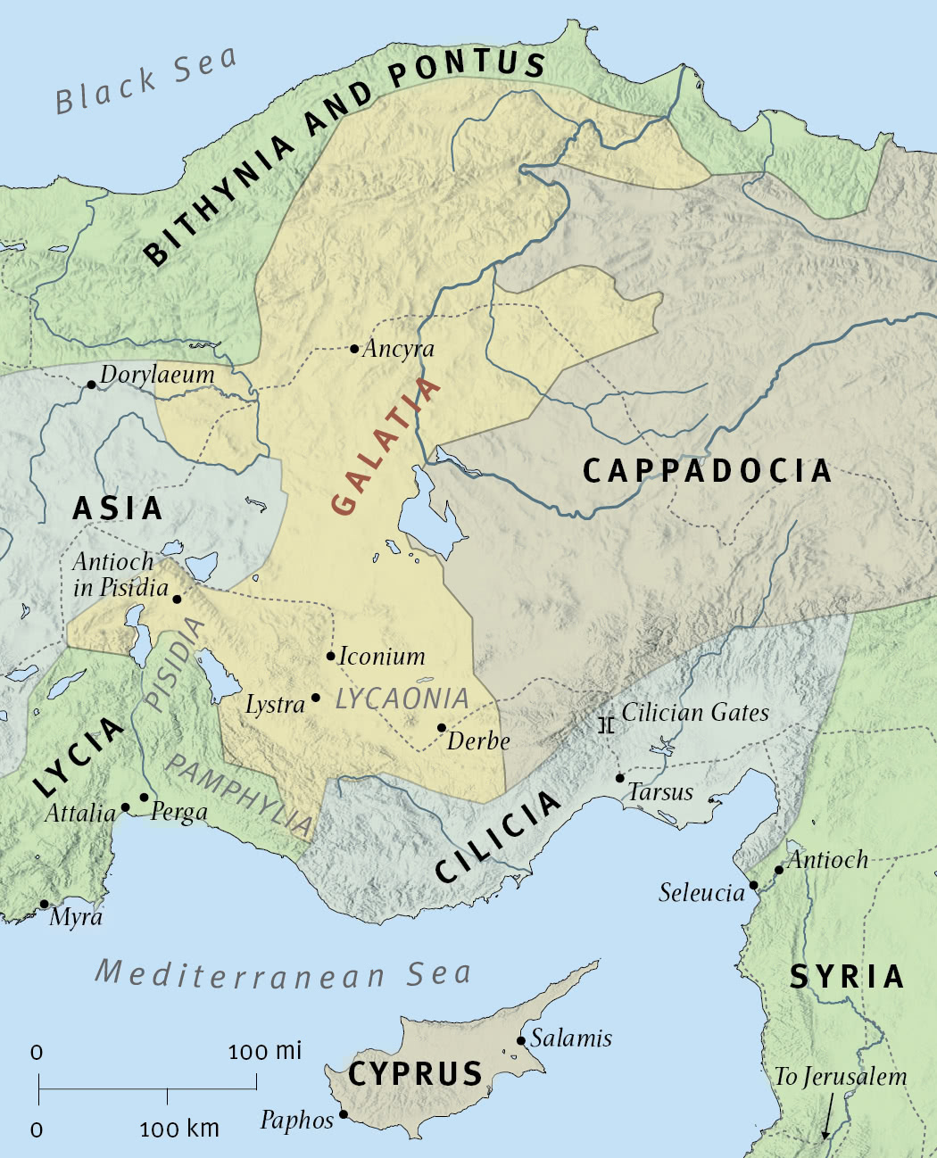
20: Paul will answer questions with truth; he has no motive to lie (2 Co.11:31)
21: Could not have received gospel from apostles while working in Syria and Cilicia.
[No other apostles in these places]

Slide 23
22: Unknown by face. He did not work in area where apostles could teach him. Stranger to Christians in Judea.

Slide 24
23: They were hearing of his conversion…
He preaches the faith (present tense) he once tried to destroy (imperfect tense)
Paul, the persecutor, tore down (v.13); Paul, the preacher, builds up (11, 16)
24: ‘They glorified God in me’ – not only approved of his work, but marveled at power of God that could harness such a persecutor!
Judaizers are ones at odds with Peter
Judean churches approved Paul’s work – a devastating blow to Judaizers. [cf. Ac.15:1]

Slide 25
Christians in Judea…
…glorified God for Paul’s preaching
Contrast: Ac.15:1, and certain men came down from Judea and taught the brethren, ‘Unless you are circumcised according to the custom of Moses, you cannot be saved.’

Slide 26
Lessons
1. Refutes Judaizers: ‘Jerusalem leaders are only persons in authority to say what true gospel is. Paul has no such authority.’
Contrast Gal.1:11-12 – not of human origin or from human source
Paul on way to Damascus to annihilate the church. God arrested him ... all Damascus knew it.
2. Certainty is wonderful
3. Authority must be respected

