Slide 1
Special Sight-Seeing

Slide 2
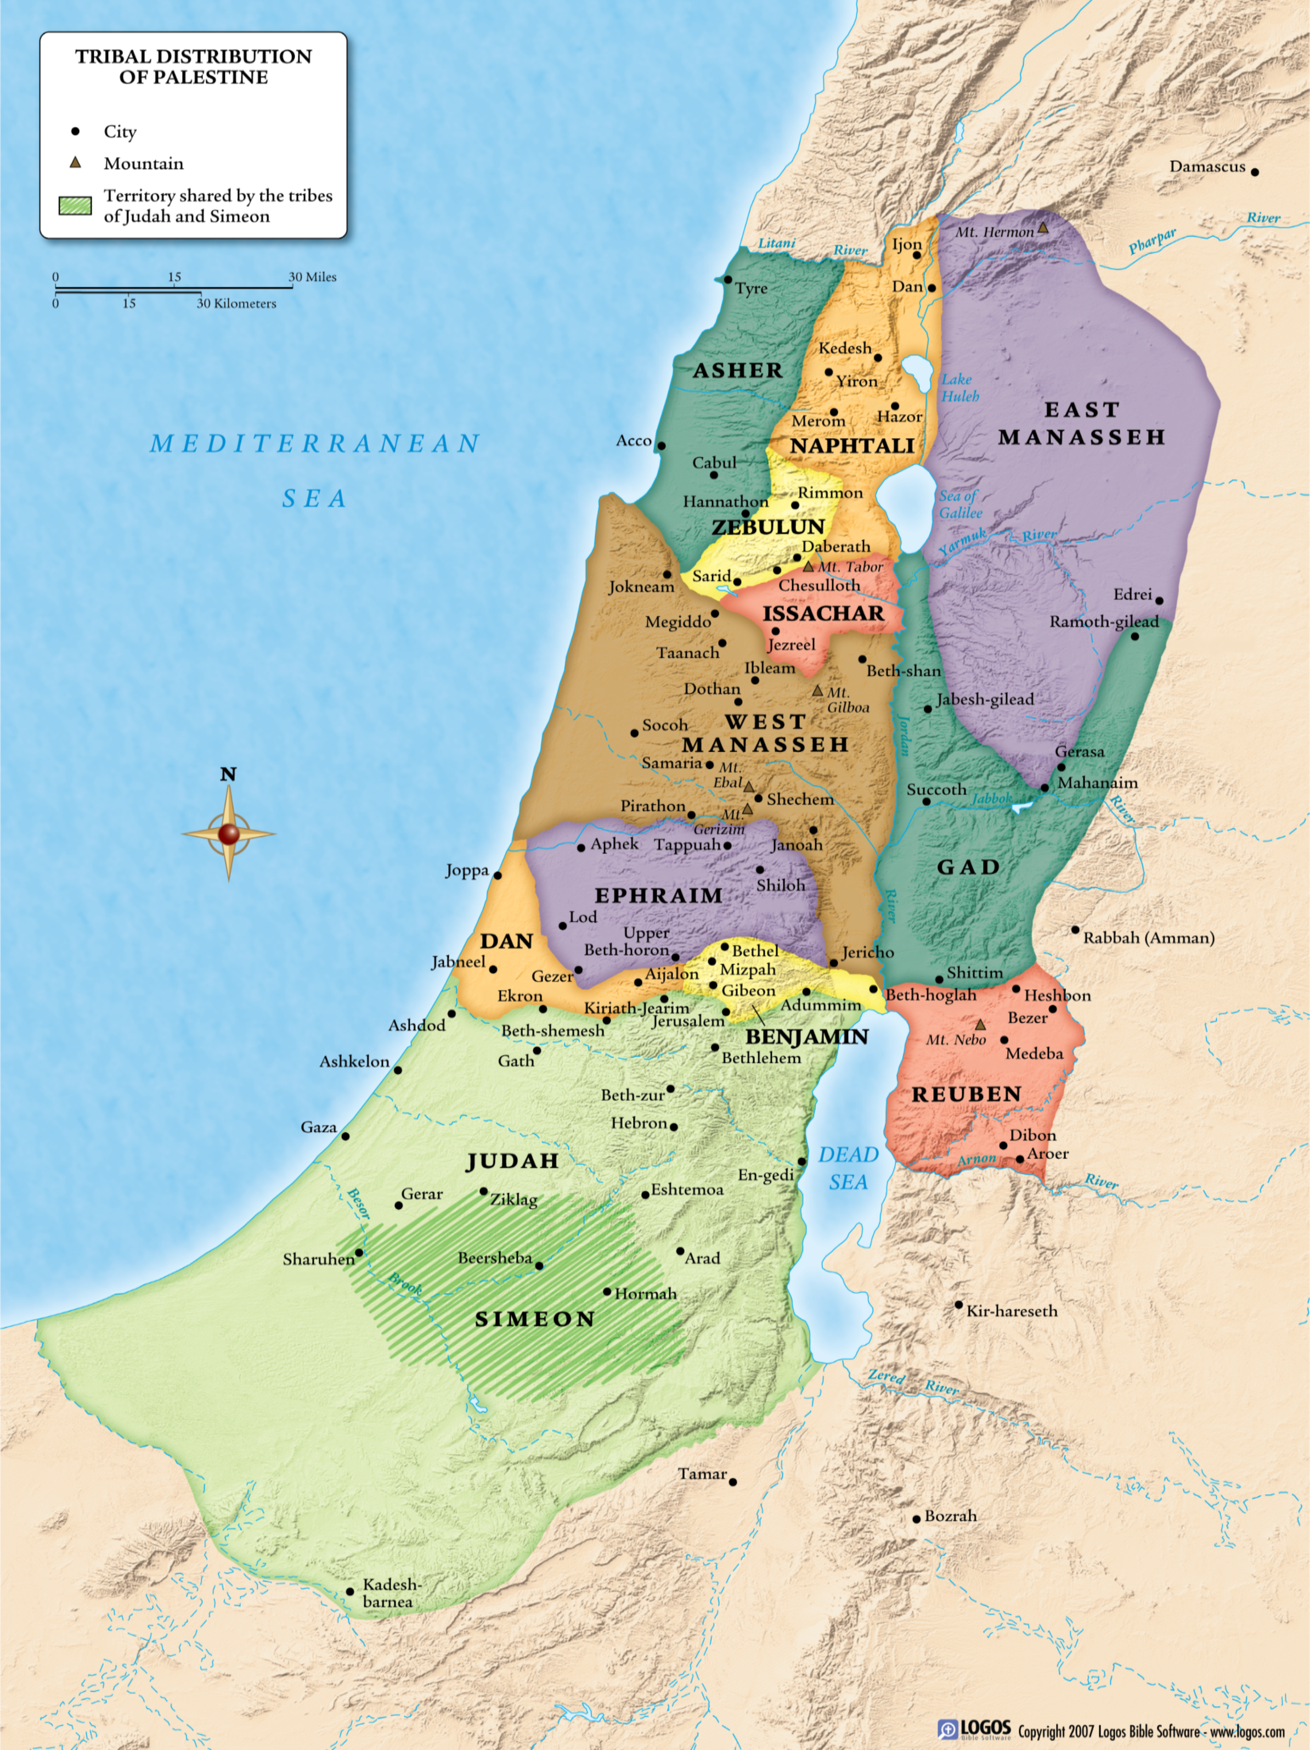
Dt.34:1, Nebo: 2600 ft

Slide 3
I. The Promised Land, 1-4

Slide 4
Tribal plots: Moses sees future fulfillment of land promise
4: God swore; always keeps His word . . . two-edged sword
Faithful enter promised land w/o Moses; Dt.1³⁷ Even with me the LORD was angry on your account and said, You also shall not go in there. ³⁸ Joshua the son of Nun, who stands before you, he shall enter. Encourage him, for he shall cause Israel to inherit it.

Slide 5
Tribal plots: Moses sees future fulfillment of land promise
4: God swore; always keeps His word . . . two-edged sword
Faithful enter promised land w/o Moses Dt.1:37-38
Faithful enter heaven; others do not. Mt.7:13-14, 21-23

Slide 6
Dt.34 – Moses highlights importance of obeying God
1. One sin is serious. Nu.13-14; 20. Dt.32:48-52
2. Edification is important. Num.12 / 20
3. Reverence God, not self. Nu.20. Dt.34; Mt.4
God sent Moses to the mountain | Satan led Jesus to mountain, Mt.4:8
Moses saw all land / tribal portions | Lord saw all kingdoms of world, v.8
God refused to let Moses enter | Jesus refused satan’s offer to rule… v.9

Slide 7
Dt.34 – Moses highlights importance of obeying God
4. Self-control is critical. Ja.3; Jn.1. Ac.2, 7, 8
5. God will punish sin. Dt.1:41-43
6. Sin may exact consequences that forgiveness cannot remove. Dt.3:23-29
7. Establishes credibility of Scripture; exposes flaws of heroes – Abraham, David, Hezekiah… Ex.32 (Aaron); Lv.10 (sons); Nu.12…
8. Proves impartiality of God. Ac.10:34-35

Slide 8
I. The Promised Land, 1-4
II. Death, The Great Leveler, 5-7

Slide 9
Moses, great . . .
A. Giver of the law, yet expendable. Christians face death in peace. Ph.1:23.
B. Servant of God: dies with boots on; works up to last hours of his life. Cf. Ex.18.
C. Leader of Israel, dies in Moab; helped Israel enter, but he cannot.
D. Man of faith in God’s house. Hb.3:2, 5-6.
E. Length of life: 120… Ec.12. Ps.90.

Slide 10
I. The Promised Land, 1-4
II. Death, The Great Leveler, 5-7
III. Israel Wept…, 8

Slide 11
During Moses’ life, Israel did not appreciate him
Some do not appreciate blessings until they lose them

Slide 12
I. The Promised Land, 1-4
II. Death, The Great Leveler, 5-7
III. Israel Wept, 8
IV. Fill In The Breach, 9-10

Slide 13
Older generations die out; others must ‘stand in the breach.’ Ps.106:19-23
Joshua prepared for years to follow Moses (comrade, not competitor); filled with wisdom (cf. Ac.6); led Israel…Israel followed
For church to survive, ground youth today in knowledge, courage
‘But I’m no Moses’ (10). Mt.11:11

Slide 14
I. The Promised Land, 1-4
II. Death, The Great Leveler, 5-7
III. Israel Wept, 8
IV. Fill In The Breach, 9-10
V. Too Stout To Doubt, 11-12

Slide 15
Evidence: signs, wonders…
Ex.14, Red Sea
Ex.19, Mt. Sinai
Ex.20, Ten Commandments
Explanation: how to deny or explain away such notable signs?
Finger of God: Ex.8:19, signs; 31:18, Word; Lk.11:20, same finger
Foes of God: Pharaoh and magicians prove Moses’ divine commission – Ex.8:19
Pharisees, Jn.3:2
Sanhedrin, Ac.4:16

Slide 16
Moses: reluctant (Ex.3-4)
Apostles: Mk.16; Jn.20, etc.
Moses:
fear became courage…
unbelief became faith…
idleness became activity
Sanhedrin did not try to duplicate signs of apostles as Egyptian magicians did with Moses, Ac.5

Slide 17
*Deut.31:16, lit., lie down with (NASB)
Jews: God took away his soul with a kiss
God’s care for His own does not cease in death or in life

Slide 18
After 40 years of service, Moses never stepped foot into the Promised land; Joshua led Israel instead
Moses finally made it (Mt.17)
Even this could not compare to the land above

Slide 19
Jn.1:17
Moses represented God’s Law
It could not lead into God’s rest
Moses had to yield to Joshua (Jesus) – Hb.4
Was Moses a good shepherd? Ex.32

Slide 20
Jude 9, Michael / archangel . . .
Controlled his speech – avoided reviling
Lofty angel – did not speak evil of satan

Slide 21
Moses and Joshua
Moses led his people to Joshua … just as the law led people to Jesus, the true Joshua (Hb.4:8-9)

