Slide 1
What if someone said that . . .
We should be like Jesus?
Being like Jesus includes sending away honest seekers?
He insulted sincere woman in need?
At first glance, He appears to do this to a mother in need – Mt.15; Mk.7

Slide 2
A Mother’s Faith

Slide 3
I. The Meeting Mt.15:21-28; Mk.7:24-30

Slide 4
Mt.15:21; Mk.7:24
Context: Mt.14, Peter’s weak faith; 15, hostile scribes / Pharisees
Lord takes disciples away from . . .
… Jews spiritually
… Israel geographically
… hypocritical unbelief to plea of faith
Tyre – Sidon

Slide 5
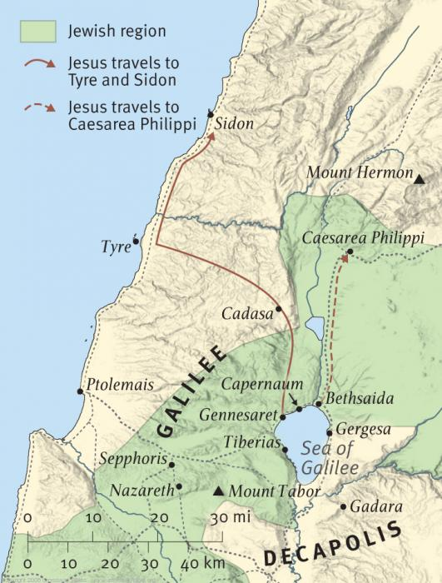
A believing heart awaits Him here

Slide 6
Mt.15:21; Mk.7:24
Context: Mt.14, Peter’s weak faith; 15, hostile scribes / Pharisees
Lord takes disciples away from . . .
… Jews spiritually
… Israel geographically
… hypocritical unbelief to plea of faith
Tyre – Sidon
He cannot hide or rest . . . even in foreign country

Slide 7
Mt.15:22; Mk.7:25-26
Woman of Canaan / Greek, Syrophoen.
‘Greek’ – heritage, or ‘alien’ (Gentile…)
Foreigner knows about Jesus
⁷ But Jesus withdrew with His disciples to the sea. And a great multitude from Galilee followed Him, and from Judea ⁸ and Jeru-salem and Idumea and beyond the Jordan; and those from Tyre and Sidon, a great multitude, when they heard how many things He was doing, came to Him – Mk.3

Slide 8
Mt.15:22; Mk.7:25-26
Woman of Canaan / Greek, Syrophoen.
‘Greek’ – heritage, or ‘alien’ (Gentile…)
Foreigner knows about Jesus
¹⁷ And He came down with them and stood on a level place with a crowd of His disciples and a great multitude of people from all Judea and Jerusalem, and from the seacoast of Tyre and Sidon, who came to hear Him and be healed of their diseases, ¹⁸ as well as those who were tormented with unclean spirits. And they were healed. ¹⁹ And the whole multitude sought to touch Him, for power went out from Him and healed them all – Lk.6

Slide 9
Mt.15:22; Mk.7:25-26
³² As they went out, behold, they brought to Him a man, mute and demon-possessed. ³³ And when the demon was cast out, the mute spoke…
Woman of Canaan / Greek, Syrophoen.
‘Greek’ – heritage, or ‘alien’ (Gentile…)
Foreigner knows Jesus. Mk.3:8; Lk.6:17-19
Cried out – (‘kept crying out’); not calm
Have mercy on me – (‘me’?)
Lord / Son of David
Little daughter – (as Mk.5:23)
Severely demon-possessed (Mt.9:32; 12:22)
²² Then one was brought to Him who was demon-possessed, blind and mute; and He healed him, so that the blind and mute man both spoke and saw

Slide 10
Mt.15:22; Mk.7:25-26
Woman of Canaan / Greek, Syrophoen.
‘Greek’ – heritage, or ‘alien’ (Gentile…)
Foreigner knows Jesus. Mk.3:8; Lk.6:17ff
Cried out – (‘kept crying out’)
Have mercy on me – (‘me’?)
Lord / Son of David
Little daughter – (as Mk.5:23)
Severely demon-possessed (Mt.9:32; 12:22)
Kept asking Him – begging

Slide 11
Mt.15:23
Not a word – 1st test of her faith
‘Disciples . . . Send her away!’
‘Cries out after us’ (as v.22)
‘The silence of God is faith’s bitterest trial’

Slide 12
Mt.15:24
‘But’ – adversative
Who is she to rewrite His mission?
He finally speaks: shuts the door (worse than His silence)
‘Israel only’ – Mt.10:5-6
2nd test of faith

Slide 13
Mt.15:25; Mk.7:25
She came
She worshipped
Fell at His feet, Mk.7:25 – Jew
She increased her pleas
She acknowledged: ‘Lord’
She begged for help – ‘come to the aid of’
His silence does not silence her
She does not lose hope, or leave

Slide 14
Mt.15:26; Mk.7:27
3rd test of faith – most severe
Not good to take… (take away, deprive)
Sheep are one thing, dogs another
Canaanites are not members of chosen family any more than dogs are
Harsh words; kindest intentions – feed children first
Many would have stormed away…
Jesus is the only way…
Ph.4:2-3

Slide 15
Mt.15:27
Quick wit
Pieces of bread = napkins
Lk.16:21
If she is a dog…give her the scraps
Jesus tested her faith, taught His disciples
They will need her faith in dark days that lie ahead

Slide 16
Mt.15:28
Then (90x in Matthew)
Woman (Jn.19:26)
Great ‘faith’ (not ‘love’)
Let it be . . . [Faith is Lord’s opportunity]
Healed . . .
¹ At request of another
² A Gentile, woman
³ At a distance
⁴ No vocal command

Slide 17
Mt.15:28
Then (90x in Matthew)
Woman (Jn.19:26)
Great ‘faith’ (not ‘love’)
Let it be . . . [Faith is Lord’s opportunity]
Healed . . .
To her house… Left Him without seeing answer to her prayer. Hb.11:1

Slide 18
I. The Meeting Mt.15:21-28; Mk.7:24-30
II. The Meaning What is great faith?

Slide 19
1. Great faith is produced by tests
Abraham: Gn.12, 22
Job
Devout Jewish sinners: Ac.2:37
Persecuted Christians: 1 Pt.1:6-9

Slide 20
2. Great faith knows Jesus cares even if He does nothing
Though He appears not to care, she believes the best in Him

Slide 21
3. Great faith blooms in unexpected people
OT parallel: Elijah / widow in Sidon, 1 K.17
Foreigners; both live in same region.
Linked to man of God / Son of God.
Both women in great need.
Humble themselves before prophet / Lord.
Trusted prophet / Lord.
Receive the reward (miracle), for their faith.
Both outdo children of Israel. Lk.4:25-26

Slide 22
4. Great faith continues even when Lord delays
Abraham / Sarah: waited for Isaac, Gn.15
Jacob: Gn.32:26
Jairus: delay getting to daughter, Lk.8
Widow: would not quit, Lk.18
Lazarus: delay getting to him, Jn.11
Woman’s faith triumphed in spite of …
Delay / silence of Lord
Comparison to dogs
Rejection as foreigner
Indifferent disciples

Slide 23
5. Great faith believes Jesus can do anything
The woman knew little of Lord – probably hearsay
BUT her faith surpassed most in Israel
Jn.1:11
Mk.9:22-24

Slide 24
6. Great faith pleases Jesus
He found Israel in unbelief, Mt.23:37
Gentiles outdid Jews – Mt.8; 15; Jn.12:20

Slide 25
7. Great faith is greatly rewarded
‘Great is your faith…’
What if our reward depends on size of our faith?

Slide 26
8. Great faith is contagious
Mt.11:21
Ac.21:3-5
Tyre – disciples – prophets – Jerusalem
Syro-Phoenicia poses no threat to gospel; Jerusalem does
Wives and children – no longer puppies under the table…

Slide 27
The woman compared to Jews
Woman merely heard of His works | Jews were eye-witnesses
She possessed great faith | Jews disbelieved
She worshipped Jesus | Jews hated Him
She wanted what He alone could give | Did not want anything from Him
She begged Him | Jews blamed Him
She thought of another: daughter | Jews thought only of themselves

Slide 28
The woman compared to Christians
A Gentile with fewer privileges –
Had this great faith
What is required of us with our multitude of privileges?
If modern parents love children as this woman did, what blessings would follow?

