Slide 1
The Purpose of Water Baptism

Slide 2
Importance of Water
Ex.30:20, priest: When they go into the tabernacle of meeting, or when they come near the altar to minister, to burn an offering made by fire to the Lord, they shall wash with water, lest they die.
Lv.14:8, leper: He who is to be cleansed shall wash his clothes, shave off all his hair, and wash himself in water, that he may be clean.

Slide 3
Importance of Water
2 Chr.4:6, lavers: He also made ten lavers, and put five on the right side and five on the left, to wash in them; such things as they offered for the burnt offering they would wash in them, but the Sea was for the priests to wash in.
Mt.3:11, John: I indeed baptize you with water unto repentance…
Jn.3:5, water, new birth: Most assuredly, I say to you, unless one is born of water and the Spirit, he cannot enter the kingdom of God.

Slide 4
Importance of Water
Acts 8:36, eunuch: Now as they went down the road, they came to some water. And the eunuch said, See, here is water. What hinders me from being baptized? 37 Then Philip said, If you believe with all your heart, you may. And he answered and said, I believe that Jesus Christ is the Son of God. 38 So he commanded the chariot to stand still. And both Philip and the eunuch went down into the water, and he baptized him.
Eph.5:26, Jesus: that He might sanctify and cleanse her with the washing of water by the word.

Slide 5
Importance of Water
1 Pt.3:20, Noah: who formerly were disobedient, when once the Divine longsuffering waited in the days of Noah, while the ark was being prepared, in which a few, that is, eight souls, were saved through water.
1 Jn.5:6, Jesus: This is He who came by water and blood—Jesus Christ; not only by water, but by water and blood.
Rv.22:17, Jesus: And the Spirit and the bride say, “Come!” And let him who hears say, “Come!” And let him who thirsts come. Whoever desires, let him take the water of life freely

Slide 6
I. Baptism stands between the sinner and salvation

Slide 7
Baptism stands between the sinner and . . .
Kingdom, Jn.3:5
Forgiveness, Ac.2:38
Washing, Ac.22:16
Calling, Ac.22:16
Death of Christ, Ro.6:3-4
Sonship, Ga.3:26-27
Putting on Christ, Ga.3:27
Sanctification, Ep.5:26
Removal of sins, Col.2:11f.
Salvation, 1 Pt.3:21
B
A
P
T
I
S
M
S
I
N
N
E
R

Slide 8
I. Baptism stands between the sinner and salvation
II. Misunderstanding stands between sinner and salvation

Slide 9
Naaman, 2 Kings 5
3: girl’s information to man in need
5-6, king’s letter, money…
6-7, king of Israel (ct. v.3 – prophet)
8, prophet (“the way…”)
9-10, clear instructions…
11, anger fail: unexpected, unscientific, humbling, test of faith. Pride took over…
12, human reasoning: (“better…”?)
13, lowly servants get it
14, went, washed, whole
15, now I know!

Slide 10
1. “Baptism is water salvation”
1. Water cured him? (10-12)
2. Healed w/o water? (13)
3. When cured? (14)
4. Who received credit? (15)
Naaman
2 Kings 5

Slide 11
Blind man, Jn.9
1: call to action: man in need
2: conclusion: ‘Who sinned?’
3: correction (neither); opportunity to display power of God
4: charge (mission): work!
5: conclusion: ‘He must be of God’
6-7: command. Precise obedience gave sight.
[Jews would not believe what Lord said or did, or what the blind man said]

Slide 12
1. “Baptism is water salvation”
1. Water cured him? (7)
2. Healed w/o water? (7)
3. When cured? (11)
4. Who received credit? (30)
Blind man
John 9

Slide 13
Saul, Acts 22:16
In Saul’s conversion, Ananias was the only unbeliever here, not in Lord’s plan of salvation, but in extent of salvation
Saul simply obeyed without question – true faith and humility

Slide 14
1. “Baptism is water salvation”
1. Water saved him?
2. Saved w/o water?
3. When saved?
4. Who received credit?
Saul
Acts 22:16

Slide 15
2. “We are not saved by works”
1. Cured without obeying?
2. Did obedience earn his cure?
Naaman
2 Kings 5

Slide 16
2. “We are not saved by works”
1. Cured without obeying?
2. Did obedience earn his cure?
Blind man
John 9

Slide 17
2. “We are not saved by works”
1. Saved without obeying?
2. Did obedience earn his salvation?
Saul
Acts 22:16

Slide 18
3. “We are saved by faith”
What is faith?
Believe: “used especially of the faith by which a man embraces Jesus, i.e. a conviction, full of joyful trust, that Jesus is the Messiah — the divinely appointed author of eternal salvation in the kingdom of God – conjoined with obedience to Christ” – Thayer, 511

Slide 19
Saved by faith
Naaman
Blind man
Saul
Without faith, what would they have done?

Slide 20
I. Baptism stands between the sinner and salvation
II. Misunderstanding stands between the sinner and salvation
III. Test case: Mark 16:15-16

Slide 21
Main sentence: He…will be saved
If this were all, we might conclude all people are saved unconditionally
Even if this passage implied universal salvation, we would need to confirm it with other passages
Are there conditions? Yes: What “he”?
“He who believes and is baptized”

Slide 22
Consider word order
“He who believes and is baptized will be saved”
1. saved
2. believes
3. baptized
(hypercalvinism)
1. believes
2. saved
3. baptized
(protestant)
1. baptized
2. saved
3. believes
(catholicism)
1. believes
2. baptized
3. saved
(Jesus, Mk.16)

Slide 23
Consider grammar
“Both acts [belief and baptism] would precede the future act [will be saved], and the meaning would be that the moment one comes to faith and baptism salvation would be his” (R. C. H. Lenski, 766)
He who believes and is baptized will be saved

Slide 24
Gospel divides people into two classes
Hb.5⁸ though He was a Son, yet He learned obedience by the things which He suffered. ⁹ And having been perfected, He became the author of eternal salvation to all who obey Him.
Jn.3¹⁸ He who believes in Him is not condemned; but he who does not believe is condemned already, because he has not believed in the name of the only begotten Son of God.
SAVED
Belief, baptism
Hb.5:8-9
LOST
Unbelief
Jn.3:18

Slide 25
“Refusal of faith necessarily excluded baptism, since such persons despised the salvation offered in the preaching of faith” (Meyer, 204).
No “faith” without baptism can save.
No “baptism” without faith is valid.
He who completes income tax forms and mails it will be refunded; he who does not complete it will pay a fine.
Immerse a sleeping man…??

Slide 26
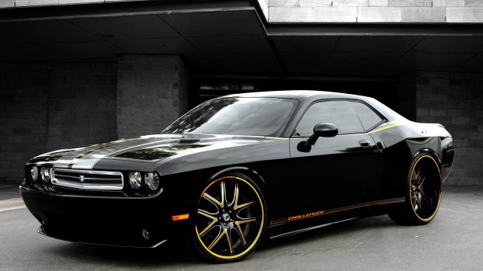
Car dealer advertisement
“Whoever believes and is immersed in our pool will receive a new car”
Claim it on faith alone?
Dad got new car without getting wet?

