Slide 1
When Jesus Went Fishing
(or: the greatest catch)
(Lk.5:1-11)

Slide 2
1
Preaching in synagogues, Lk.4:43-44
Now, near the Lake of Gennesaret…

Slide 3
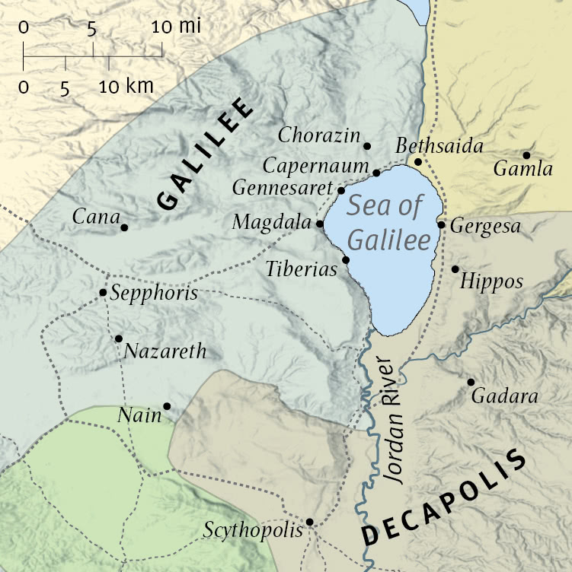
Lake of Gennesaret
Sea of Tiberias
Sea of Galilee
In Jesus’ day, nine townships clustered around shores

Slide 4
1
Multitude pressed about Him
Eager crowd was common
What He said
How He said it
What He did (Mk.12:37)
To hear the word of God

Slide 5
2
Two boats – one became portable pulpit
Nets
Hook: Mt.17:27 (Temple tax). Am.4:2, used on Israel.
Fishing spears: Job 41:7: depicted in Egyptian inscriptions.
Dragnet (drawnet): Mt.13:47-48.
Hand net (casting net) Mk.1:16-17. Circular form, about 15’ diameter, with lead sinkers.

Slide 6
3
Creator of universe borrowed a boat . . .
womb…donkey….room…tomb
Jesus had already renamed Simon (Jn.1:42)
Mk.1:16-18
Lk.4:38-39
Jesus sat and taught (as audience usually sat, 4:20)

Slide 7
4
“your” (plural) nets – hired men, Mk.1:20
Was Lord paying rent? Concerned for disap-pointed fishermen?
Does a carpenter know more about fishing than professional fishermen?
He orders Peter to . . .
An unlikely place (deep water)
At wrong time (near noon?)

Slide 8
5
Peter has stayed with Jesus in the boat as He preached
Peter ‘knew’ this plan would not work:
Day
Fish are not ‘biting’
Peter shows respect: Master (6x in Luke) – One whose orders must be obeyed
Peter will trust and obey

Slide 9
6
Miracle: He caused this result at this moment
Great number…net breaking
Jn.21:…11
Reveals –
Omniscience. Jn.1:47-49
Omnipotence. Mt.17:27

Slide 10
7
Signaled: fishermen communication
Sink: nets and boats too small
8
‘Lord’ – (v.5, ‘Master’)
Peter … fell at Lord’s knees, ‘Depart…’
Ex.20:9, Israel; Jg.13:22, Manoah…
Miracle invaded Peter’s turf: fishing

Slide 11
9
Astonished: ‘surround; take hold of completely; seize, come upon – amazement seized him.
10
Partners (in business) with Simon
Do not fear (stop being afraid)
Best catch of all – people

Slide 12
11
Walked away from the greatest catch . . .
1. Already believed on Him as Messiah, Jn.1:35ff.
2. Had become His companions without leaving jobs, Mt.4:18-22
3. Now, they forsake all
Huge catch would supply needs of their families
Only he who leaves all can gain all

Slide 13
I. The promise (4)

Slide 14
“For a catch”
After a long night…yet Peter drops net at His command…
Experienced fishermen knew it was hope-less, but…
‘Sinful man’ (8). 1 Tim.1:15

Slide 15
I. The promise
II. Launch out into the deep (4)

Slide 16
Go where the fish are
Depth
Mt.13:5, stony soil: 20-21
Do not be a shallow disciple in . . .
1. Commitment, Rv.3
2. Knowledge, Ep.3¹⁸ may be able to comprehend with all the saints what is the width and length and depth and height—¹⁹ to know the love of Christ which passes knowledge; that you may be filled with all the fullness of God.

Slide 17
Depth requires . . .
Study – dig deep. 2 Tim.2:15
Submission – 1 Tim.1:15
Scrutiny – 1 Co.11:28
Sanctification – Jn.17:17
Steadfastness – 1 Co.15:58. Fishermen are patient…

Slide 18
I. The promise
II. Launch out into the deep
III. Fishers for men (5-10)

Slide 19
Fishers worked all night – caught nothing (5)
If we work to catch souls, we are a success if we catch nothing
6: what is success
“They caught a boatload of fish”??
Correct answer: they obeyed the Lord
They obeyed even if the command seemed foolish

Slide 20
I. The promise
II. Launch out into the deep
III. Fishers for men
IV. The catcher is caught, (8-9)

Slide 21
Peter’s progress
1. Familiarity with the Teacher (3)
2. Faith in the Master (5)
3. Fear before the Lord (8)

Slide 22
Peter’s struggles (8-9)
Seized with fear, amazement, awe (as 4:36) and humility.
11: they leave it all behind.
Being caught is better than catching.
Only other alternative – 2 Tim.2:26
Not so wedded to work, family, recreation that they do not follow Jesus.
Lk.18:28, all apostles

Slide 23
Acts 2:…41, first casting of the net…
People on Pentecost did what Peter and partners did –
Listened when Lord speak
Labored when He commanded
Believed what He promised
Followed where He went

Slide 24
The biggest catch
NOT Lk.5:6
NOT Ac.2
BUT Lk.5:11 – Jesus hooked the fishermen – they forsook all, followed Him
Their spiritual fishing would catch innumerable souls

