Slide 1
The Ideal Church
(Ephesians 4)

Slide 2
Truth
People
People
Truth

Slide 3
Restoring NT church: where there are people, there are problems
What about Corinth? …Laodicea? …
U.S.
Family
Church
“Restore” NT church?
NT: “ideal”
Hb.10:32-34
Rv.2:4-5
Ep.4:1-16

Slide 4
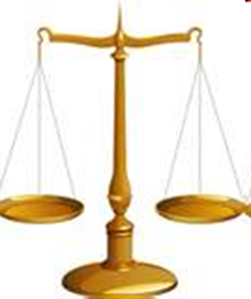
1: Walk worthy of the calling…
Prisoner
…of the Lord: prison epistle (3:1; 4:1; 6:20)
Walk worthy: “to balance”
…of your calling: in harmony with…
“Highest calling demands highest conduct”

Slide 5
Characteristics of The Ideal Church
I. Members show proper attitudes toward one another

Slide 6
Four words (v.2)
Lowliness – humility, modesty. (Ro.12:3)
For I say, through the grace given to me, to everyone who is among you, not to think of himself more highly than he ought to think, but to think soberly, as God has dealt to each one a measure of faith.
Ph.2:5, Let this mind be in you which was also in Christ Jesus ... 8, And being found in appearance as a man, He humbled Him-self and became obedient to the point of death, even the death of the cross

Slide 7
Four words (v.2)
Gentleness – quality of not being overly impressed by a sense of one’s self-impor-tance; gentleness, humility, courtesy, considerateness, meekness. (Nu.12). Mt.21:5
“Tell the daughter of Zion, ‘Behold, your King is coming to you, Lowly, and sitting on a donkey, A colt, the foal of a donkey.’ ”

Slide 8
Four words (v.2)
Longsuffering – opposite of short-tempered, irritability. Patience under provocation. Loving the unlovable. 2 Pt.3:9, 15
⁹ The Lord is not slack concerning His promise, as some count slackness, but is longsuffering toward us, not willing that any should perish but that all should come to repentance. … ¹⁵ and consider that the longsuffering of our Lord is salvation—as also our beloved brother Paul, according to the wisdom given to him, has written to you

Slide 9
Four words (v.2)
Bearing with one another – Have patience with; endure; put up with. Opposite of nit-picking, fault-finding, anger. Ro.2:4
Or do you despise the riches of His good-ness, forbearance, and longsuffering, not knowing that the goodness of God leads you to repentance?

Slide 10
Characteristics of The Ideal Church
I. Members Show Proper Attitudes Toward One Another
II. Members Manifest Unity of the Spirit

Slide 11
Unity takes work (v.3)
Endeavoring: hurry, hasten, make every effort
Anyone can divide, cause trouble…
Seven unifying factors: ONE
body
Spirit
hope
Lord
faith
baptism
1 Co.1:10-12
God
1 Co.12:13

Slide 12
Characteristics of The Ideal Church
I. Members Show Proper Attitudes Toward One Another
II. Members Manifest Unity of the Spirit
III. Members Manifest Grace of God Through Gifts He Gave

Slide 13
Ephesians 4
⁷ But to each one of us grace was given according to the measure of Christ’s gift. ⁸ Therefore He says:
“When He ascended on high, He led captivity captive, And gave gifts to men.”
[9-10]
¹¹ And He Himself gave some to be apostles, some prophets, some evangelists, and some pastors and teachers

Slide 14
Ascension of Christ (v.8-10)
1. Led captivity captive
– Jgs.5; Ps.68:18; Lk.4:18
2. Gave gifts to men (main point)
11: He gave . . .
1. Apostles. Lk.16:29-31
2. Prophets. 1 Co.13:8
3. Evangelists. 2 Tim.4:5
4. Pastors. Shepherds, 1 Pt.5:2
5. Teachers. 1 Co.12:28

Slide 15
Characteristics of The Ideal Church
I. Members Show Proper Attitudes Toward One Another
II. Members Manifest Unity of the Spirit
III. Members Manifest Grace of God Through Gifts…
IV. Manifest True Spiritual Growth

Slide 16
Purpose of the gifts (v.12)
Edification of body
Equip saints
Work of ministry

Slide 17
What does spiritual growth produce? (13-16) –
Unity of the faith (13)
Knowledge, maturity
Perfect man
Stability (14)
Christ-likeness (15)
Edification (16)
Joined. Architectural term. Building, many parts framed together…
Knit together. Joined; many become one

Slide 18
Three giant apostasies
1. Roman Catholicism
2. Missionary society / mechanical music
3. Institutionalism
If all heed Ep.4, we will never divide

