Slide 1
Growth

Slide 3
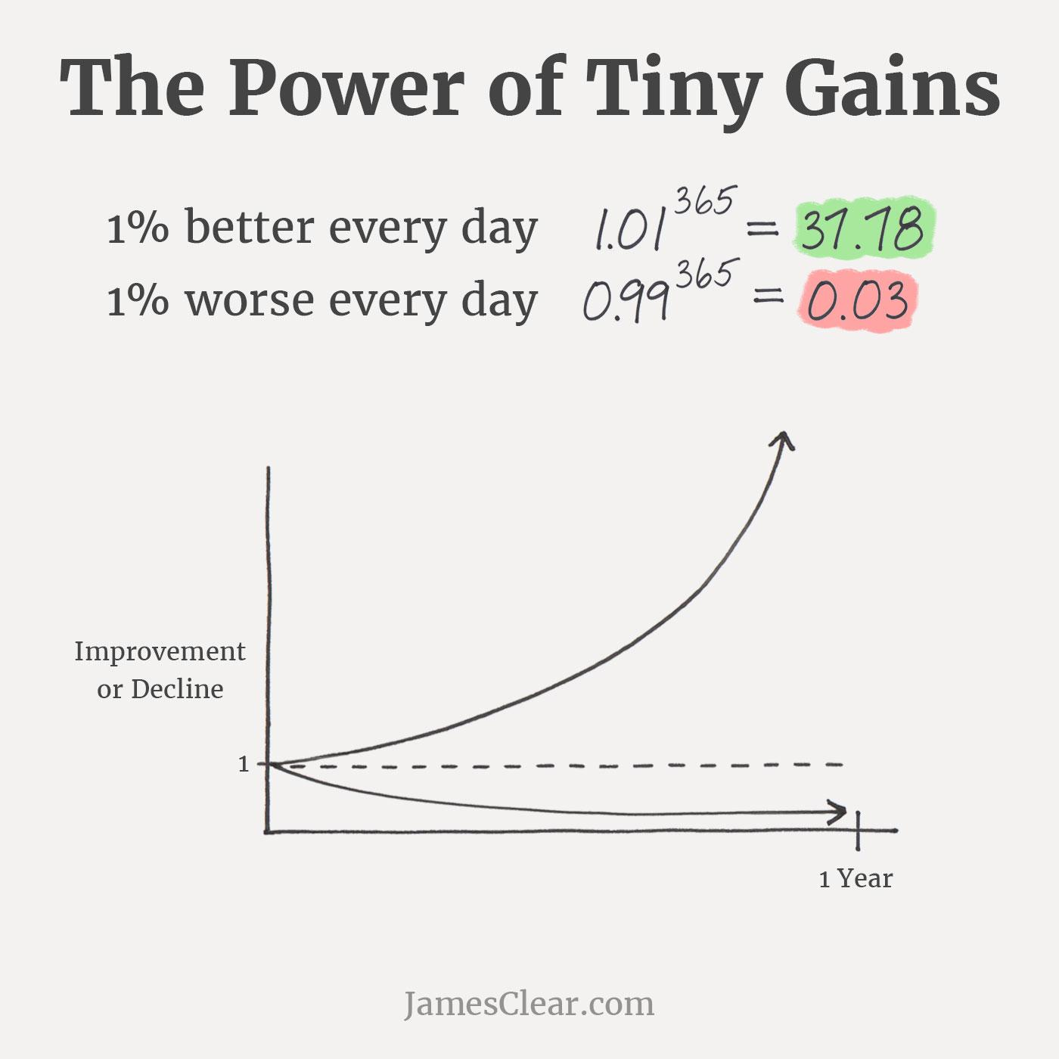

Slide 4
