Slide 1
September 9-10-11, 2022

Slide 2
Friday – I Believe in Hope
Saturday – Hope for when Life Disappoints
Sun Bible class – Hope for Overcoming Sin
Sunday A.M. – It’s Hard to be Lost: Our Hope of Heaven
Sunday night – New Hope in Evangelism
“We have this as a sure and steadfast anchor of the soul”

Slide 3
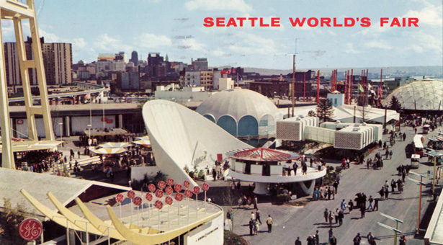
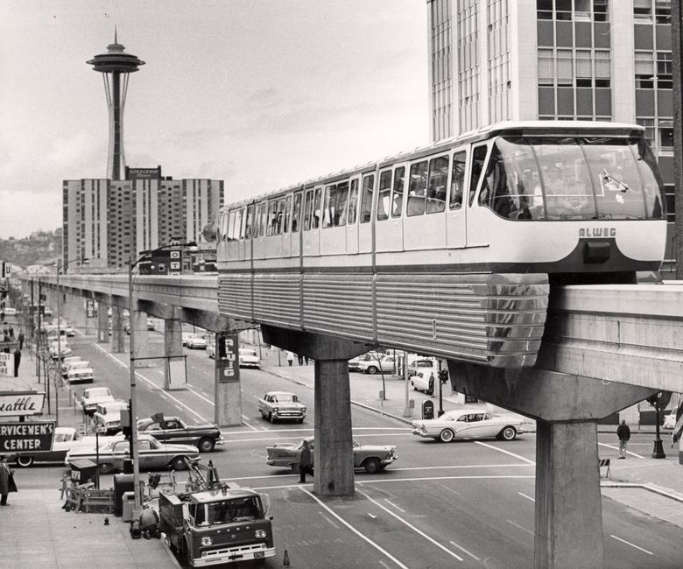

Slide 5
I Believe in Hope

Slide 6
Hope is central to discipleship.

Slide 7
“Because of ______________ I will be okay some day.”

Slide 8
We can’t anchor to false hopes.

Slide 9
If our hope is so far off, how can we anchor to it?

Slide 10
Christianity is more than future … it’s an anchor now.

Slide 11
GETTING MORE HOPE
Shut out the hope killers.
Be a hope sharer.
Read the Bible looking for hope.

Slide 12
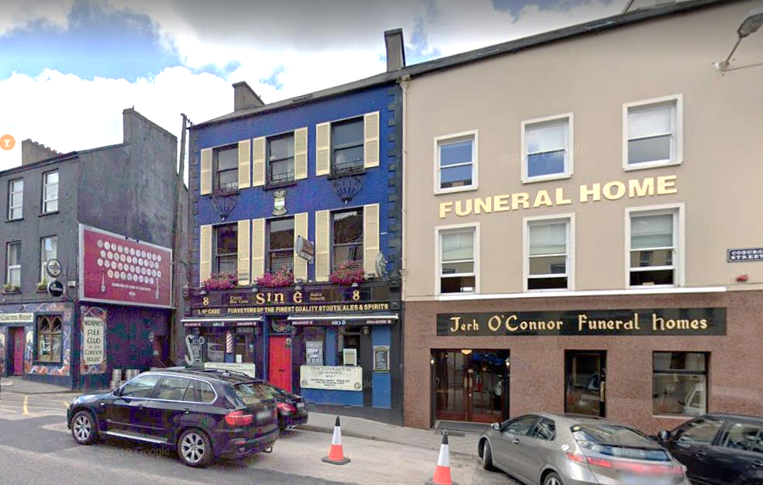

Slide 13
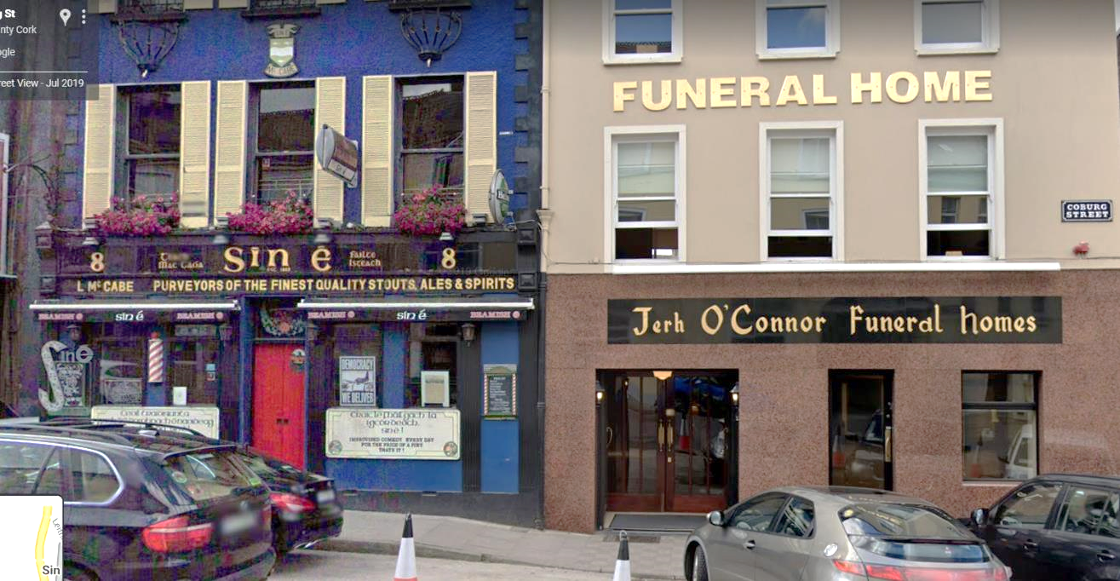

Slide 14
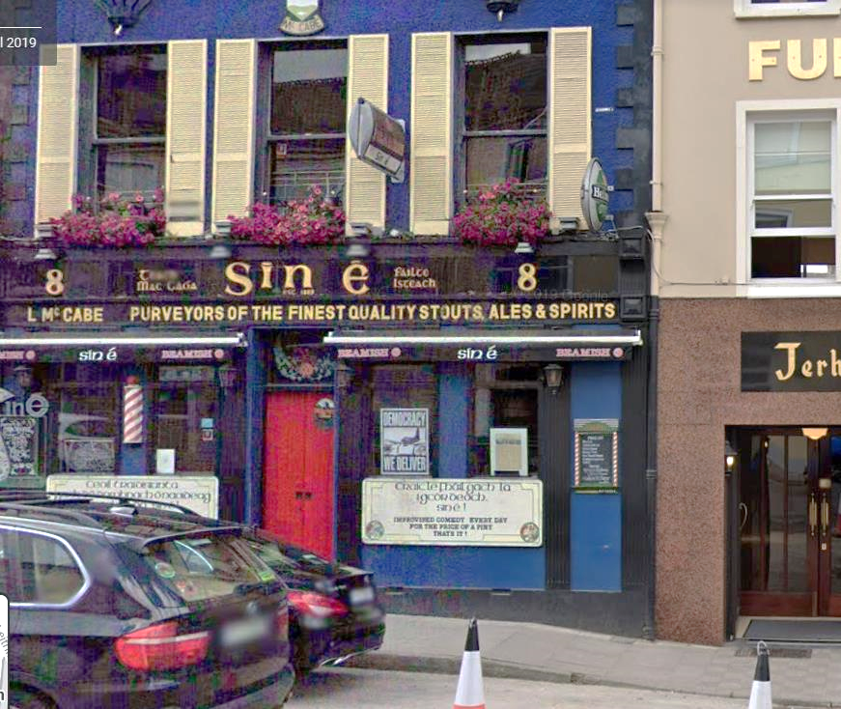

Slide 15
I Believe in Hope

