Slide 1
September 9-10-11, 2022

Slide 2
Friday – I Believe in Hope
Saturday – Hope When Life Disappoints
Sun Bible class – Hope for Overcoming Sin
Sunday A.M. – It’s Hard to be Lost: Our Hope of Heaven
Sunday night – New Hope in Evangelism
“We have this as a sure and steadfast anchor of the soul”

Slide 3
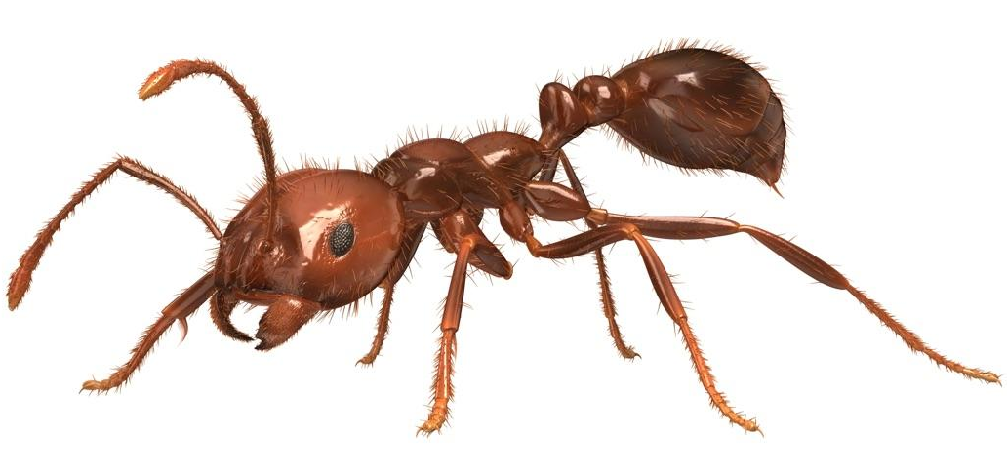
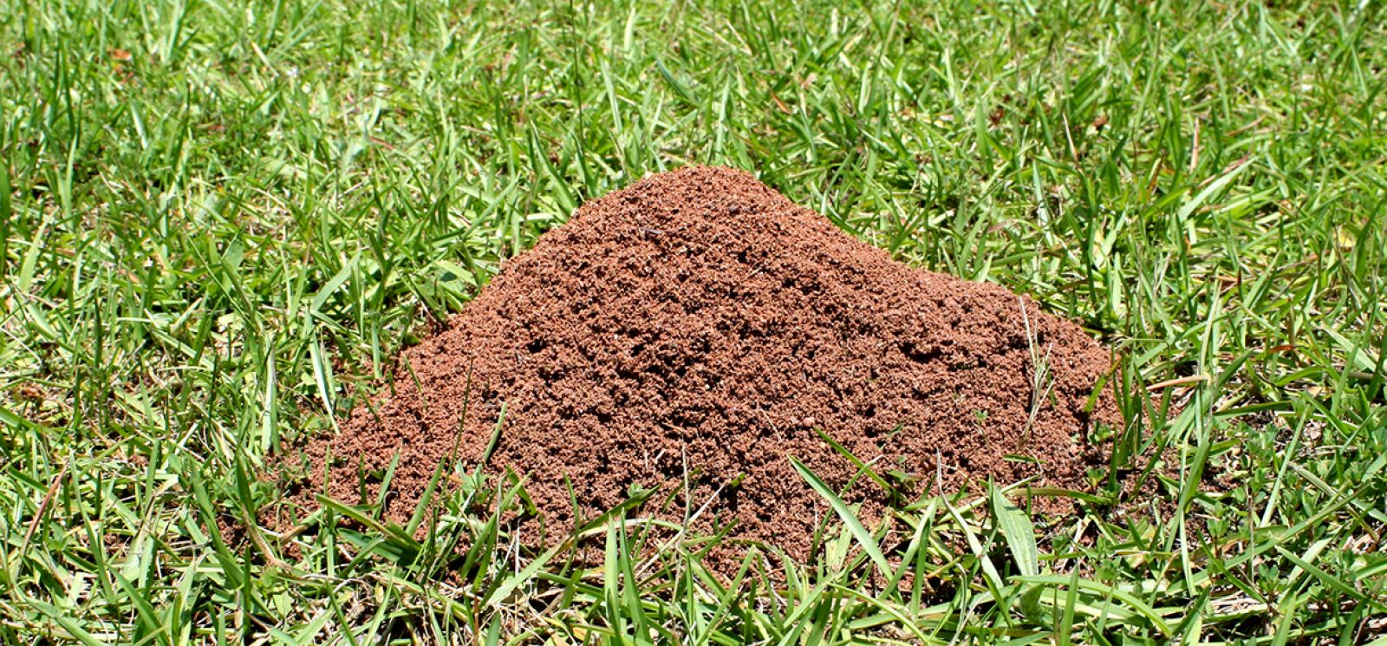

Slide 4
Killing Sin
Hope for Overcoming Sin from Colossians 3

Slide 5
Killing Sin
Don’t fall for gimmicks, ch. 2
Know your identity, 3:1-4
Decide it can be done, 3:5
Don’t coddle sin, 3:5b
Realize what sin does, 3:6
Practice righteousness, 3:12-17

Slide 6
Killing Sin
Hope for Overcoming Sin from Colossians 3

