Slide 1
Temptation of Christ
Mt.4:1-11

Slide 2
Two times when satan attacks
1. Elijah – 1 K.18 . . . 19
2. Jesus – Mt.3 . . . 4
Devil thought he could derail Jesus at the beginning of His ministry

Slide 3
I. The Text – Mt.4:1-11

Slide 4
Led up by the Spirit…Jordan to wilderness, from Spirit to place of Israel’s sin
Jesus aggressively resists satan
Devil led every saint into sin –
[Abraham; Moses; Job; David; Isaiah; Daniel]

Slide 5
To be tempted by satan. Gn.3
Why did He go?
1. To defeat satan
2. To protect us
3. To release hostages
If Jesus sins, He will need John’s baptism (3:13-15)
If Jesus sins, we lose (one sin sinks our salvation)

Slide 6
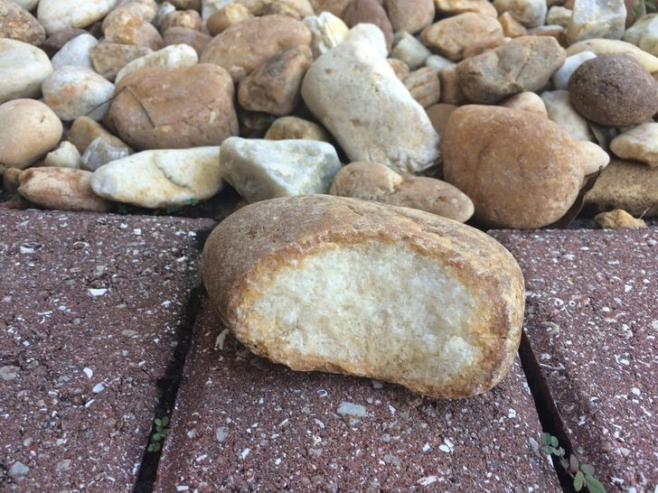
Fasted forty days (2)
The tempter (3) – number one
“If you are [the] Son of God…” [3:17; 27:40]
Hopes He will misuse His power to benefit Himself, not others
Design: derail Jesus at the beginning
We are not tempted to use such powers
Stones…bread…
Physical weakness
Israel did not fast 40 days…

Slide 7
It is written (4)
“Guided by God’s word…” (Dt.8:3)
“Man shall not live by…”
Even good things can lead to sin
Some never rise above physical level of life: food, job, paycheck, clothes, shelter, medical care…

Slide 8
It is written (4)
“But by every word…”
But: huge contrast
By: the means
Every word: no minor, unimportant, unnecessary word of God
Word: not feelings, past experience, other people, religious leaders, common sense…
Mouth: not intuition, imagination, individual taste…
Of God: excludes human attempts
1 Our thoughts, desires, needs, 2 K.5
2 Majority opinion, Mt.23
3 Religious leaders, Mt.3
4 Family, Mt.10
5 Tradition, Mt.15

Slide 9
The temple (5) – number two
Then…
Holy city. Acts 5. 1 Cor.11.
Pinnacle of Temple
Prove your faith in God
Prove power of God
Prove reliability of God’s promises

Slide 10
If You are the Son of God… (6)
Devil’s “it is written”
Jump at opportunity to show trust
His angels
Implication: Jesus is a fraud; doesn’t trust God

Slide 11
Jesus responds… (7)
It is written again – not contradiction but harmony
Again. Take all God says on subject. Dt.6:16; Ps.119:160
Not tempt… [put God to test…]
Ps.91:11-12, speaks of journeys, NOT dare-devil feats
Angels guard God’s people . . .

Slide 12
The mountain (8) – number three
From high point of temple to very high mountain
Their glory

Slide 13
The mountain (9)
All these things I will give you – the generous tempter
Satan, the great liar (Gn.3; Jn.8:44)
Jesus is King of kings; satan offers fakes. Mt.28:18
Do we know this?
What is worth the loss of your soul? (Gn.3)
If You fall down…worship me…

Slide 14
Away with you, Satan! (10)
‘Satan’ – adversary
It is written.
Only. Not in Hebrew text of Dt.6:13 or LXX
“Only” = interpretive expansion
Based on context: Dt.6:14; 5:9
1 Chron.15:2
1 Sm.7:3, ‘serve Him only’

Slide 15
Then devil left Him (11)
Then … satan more than met his match. Utter defeat.
Left Him… sounded retreat. Lk.4:11, until an opportune time (NKJV; NASB: ESV).
He never goes far away; does not quit. 16:21-23, uses Peter. Jn.6:15, others…
Angels … More proof that He was tempted as a Man.

Slide 16
I. The Text: Mt.4:1-11
II. The Teaching

Slide 17
1. Lord’s temptations were real.
Hb.2:18
Hb.4:15-16
One purpose of His temptations: assures us of His sympathy in our temptations
Jesus was tempted as we are, without sin

Slide 18
2. He defeated satan with same sword we use
Eph.6:17, take…the sword of the Spirit, which is the word of God.
3. By rejecting satan’s temptations, Jesus received the very blessings satan offered Him

Slide 19
4. Temptation leads to sin only when we let it
5. No temptation is beyond our power to resist.
1 Co.10:13, No temptation has overtaken you except such as is common to man; but God is faithful, who will not allow you to be tempted beyond what you are able, but with the temptation will also make the way of escape, that you may be able to bear it.

