Slide 1
I A Church to Imitate
1 Thessalonians 1

Slide 2
A church takes a risk when it imitates other churches
Some imitation is good – 1 Th.2:14
We should imitate Thessalonians – 1 Th.1:7

Slide 3
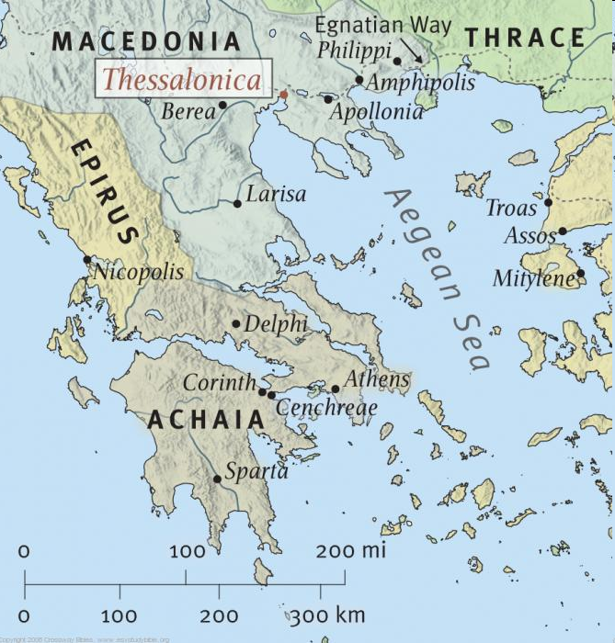
Acts 17
(2nd journey)
AD 51
Paul received gifts: Ph.4:15f

Slide 4
1: in God the Father and the Lord Jesus Christ
“Lord”: Jehovah in OT
“Christ”: anointed one [prophet, priest, king]
No higher view can be taken of Christ
Grace: favor, kindness, God’s gifts (1); Gn.6:8
Peace: prosperity, wholeness. 2 K.4:26

Slide 5
2: thanks to God for you (without ceasing)
or (without ceasing) remembering (v.3)
NKJV: making mention of you in our prayers, 3 remembering without ceasing your work of faith [also ASV; NASB; NRSV; NIV]
ESV: 2 constantly mentioning you in our prayers, 3 remembering before our God and Father your work of faith
Praising God for them also praises them

Slide 6
3: Lord Jesus Christ (v.1-3)
Remembering . . .
Work of faith – faith works
Labor of love – love toils
Patience of hope – hope endures

Slide 7
4: knowing…
Lead verb (2): “give thanks”
Your election by God (2 Th.2:13)
2 Pt.1¹⁰ Therefore, brethren, be even more diligent to make your call and election sure, for if you do these things you will never stumble; for so an entrance will be supplied to you abundantly into the everlasting kingdom of our Lord and Savior Jesus Christ.
2 Th.2:14 . . . Mt.22:1-14

Slide 8
5-6: how did Paul know they were elect?
5: For… (gospel) … not in word only ... in power and Holy Spirit … in much assurance
Ac.17:1-4, some Jews & Greeks believed
Ac.17:5-8, other Jews & Greeks rejected
1 Th.2:14-16, Jews tried to hide gospel…

Slide 9
5-6: how did Paul know they were elect?
5a-6: you became imitators of us and Lord... having received the word . . .
1 Th.2:13
Hb.6:11; 10:22

Slide 10
7: you became examples
Model, pattern. (2 Th.3:9)
Macedonia (N. Greece)
Achaia (S. Greece)
Who believe (t.t.: Christians, Ac.2:44)
“First they followed their preachers as a living pattern or example ... they in turn became an example, a pattern for the imitation of other churches” – Eadie

Slide 11
8: for from you…
Local church taught locally and universally [Macedonia / Achaia … AND every place]
Receivers (6) become transmitters (8)
Sounded forth: of trumpet, roll of thunder – from Thessalonica to Greece to the world
2 Co.8:1-2

Slide 12
9-10: reports of the kind of visit we made and your response to the gospel
Turned to God from idols [change direction]
Serve the living and true God [all of life is redirected]
Wait for His Son from heaven [ready for His coming, 4:16]

Slide 13
I. Work Of Faith, 3
(The work that faith accomplishes)

Slide 14
What is faith?
Gn.4, Abel . . . Hb.11:4 / Ro.10:17
Based on the Word of God
Faith does . . .
1. What God says: Lv.10, unauthorized fire is not safe.
2. Way God says: 1 Chr.15, cart worked but not God’s way.
3. Why God says: Ac.19:1-7, immersed, but in John’s baptism.

Slide 15
Paul commends their work of faith
Implies the Word . . .
1. Directed them, 6. 1 Pt.4:11
2. Dwelled in them, 8. (Influence)
3. Defined them, 8. People associated them with the gospel.
4. Detached them, 9-10. Turned to God, from idols…

Slide 16
Paul commends their work of faith
4. Detached them, 9-10.
False religions use gimmicks. 1 K.12
Walking by faith (Ro.10:17; 2 Co.5:7)

Slide 17
I. Work Of Faith, 3
II. Labor Of Love, 3
(The effort that love produces)

Slide 18
Labor
“To engage in activity that is burdensome, work, labor, toil” (BDAG). Ga.5:6.
But 1 Jn.5:3, not burdensome??
Song of Sol.8:7
Jacob, Gn.19:18, 20
Laban, Gn.31:38-42
Same actions, same time, different attitudes.
When love is the motive, labor is light.

Slide 19
Labor
“To engage in activity that is burdensome, work, labor, toil” (BDAG). Ga.5:6.
Jn.14:15, real love obeys
Jn.15:12, love is unselfish
Churches talk about love, then offer naïve people a false gospel.

Slide 20
I. Work Of Faith, 3
II. Labor Of Love, 3
III. Patience Of Hope, 3
(The endurance that hope inspires)

Slide 21
Patience keeps on going.
“Hope is golden” – Homer.
Ancients stressed importance of hope (though they had no foundation for it).
Human hope cannot deliver.
Lord gives true hope. Tit.1:2.
“Other men see only a hopeless end, but the Christian rejoices in an endless hope” (Beenken)

Slide 22
True hope focuses on Christ and His coming
Tit.2:12, hope desires and expects life
1 Th.2:19, hope for salvation of brothers
1 Th.4:13, hope for the dead
1 Th.5:8, hope for salvation
Hope: “endurance under trial.”

Slide 23
I. Work Of Faith, 3
II. Labor Of Love, 3
III. Patience Of Hope, 3
IV. Result: become example to all

Slide 24
Their example
Preaching gospel, 7
Edification, 5:11
Benevolence when necessary. 2 Co.8

Slide 25
Expecting the Son (10) (Getting ready for Christ)
Excitement, 8. [Explains work ethic]
Example, 7. [People are watching us]
Evangelism, 8. [Want others to be ready]
Earnestness, 9-10.

