Slide 1
Sanctified Uncommon Sense

Slide 2
Sanctified common sense
Cannot rise to level of sanctified Scripture sense, as 1 Thes.4
After regaining his composure (ch.3), Paul begins to ground the Thessalonians in holy living
3:10… implies defects
4:1… begins to address them

Slide 3
Paul’s epistles consist of two parts
1. Personal: thanks and encouragement (1 Th.1-3)
2. Practical: teaching and exhortation (1 Th.4-5)
“Finally then, brethren…” begins general encouragement to purity
“Brethren, we urge (ask) and exhort” –
After the thanks comes the teaching

Slide 4
I. Person, 1: “We”

Slide 5
Paul is the Lord’s spokesman
Ought (must) – it is necessary. Jn.3:7; 4:24
Walk (live) – 2:12. Gn.5:24. Hb.11:5-6
More and more – spiritual growth; more and more pleasing. Increase in excellence; progress (3:12; 4:10)
Never be satisfied with growth. 2 Pt.3:18
Mt.15:33; 5:6
2 Co.3:18
Ja.1:25

Slide 6
I. Person, 1
II. Precepts, 2

Slide 7
Command we gave you through Lord Jesus
Lord legislates and enforces laws, 6
Paul is not legislator, but messenger

Slide 8
I. Person, 1
II. Precepts, 2
III. Purpose, 3

Slide 9
Will of God
Depart from sin ...(Mt.6:10)... Devoted to God
Sanctification, 3, 4, 7 (holiness)
Sanctified: to be subject to God’s will – Hb.10:10

Slide 10
Will of God
Sanctified: to be subject to God’s will.
Abstain: sanctification requires a life of submission to His will and separation from sin. Have good sense to be afraid!
Ac.15:29
Hot stove / street / knife / gun / lust . . .
Chaste living is the critical factor in Thessalonian sanctification

Slide 11
Will of God
Sanctified: to be subject to God’s will.
Abstain: sanctification requires a life of submission to His will.
Sexual immorality:
Stands first in sin lists. 1 Co.6:9; Ep.5:3
Surrenders to former habits.
“The deadly sin here reprobated…was excused by parents, commended by moralists, and consecrated by the Religion of Heathenism, especially in Greece, and particularly at Corinth where…Paul now was” – Wordsworth

Slide 12
Will of God
Sanctified: to be subject to God’s will.
Abstain: sanctification requires a life of submission to His will.
Sexual immorality:
Stands first in sin lists. 1 Co.6:9; Ep.5:3
Surrenders to former habits.
Surrounds Christians in immoral society.

Slide 13
I. Person, 1
II. Precepts, 2
III. Purpose, 3
IV. Protection, 4

Slide 14
Know how to possess own vessel
Two possibilities –
1. Take a wife for himself. 1 Co.7:2; 1 Pt.3:7
2. Gain control over own body.
2 Co.4:7
1 Sm.21:4-5
In sanctification (to God) and honor (to other people) – not sinful lust (v.5). 2 Co.7:1
Hb.13:4. 2 Sm.12:14, 9

Slide 15
I. Person, 1
II. Precepts, 2
III. Purpose, 3
IV. Protection, 4
V. Passion, 5

Slide 16
Passions (of lust); dominated by animal desires. Depraved passion.
“Gentiles that do not know God” (Ga.4:8)
Ignorance: Ro.1:24, 26, 28
Roman society of Thessalonia = U.S.
1 Pt.4:3
Knowing God is more than intellectual action or mere obedience. Tit.1:16
Jonah
“Man first denies his Maker, and then degrades himself” – Findlay

Slide 17
I. Person, 1
II. Precepts, 2
III. Purpose, 3
IV. Protection, 4
V. Passion, 5
VI. Prohibition, 6

Slide 18
Do not mistreat a brother
One way, two words
Take advantage: transgress by going beyond proper limits in behavior, trespass, sin
Cannot break this rule without cheating others
Defraud: take advantage of, outwit, defraud, cheat
Ro.12:17 … 21
Judgment Day casts its lengthy shadow over all of life – unknown

Slide 19
Do not mistreat a brother
Lord is the avenger of all such.
Num.32:23
Hb.13:4
Ro.13:4

Slide 20
Do not mistreat a brother
Lord is the avenger of all such.
Num.32:23
Hb.13:4
Ro.13:4
In all these things.
Jesus – One through whom God judges the world at the Last day. 2 Th.1:7-9

Slide 21
I. Person, 1
II. Precepts, 2
III. Purpose, 3
IV. Protection, 4
V. Passion, 5
VI. Prohibition, 6
VII. Purity, 7

Slide 22
Not . . . born to be wild. Called to the most thorough holiness.
God’s ‘call’ is the foundation of the Christian’s life
Not to uncleanness, but holiness (= 3-4)
Ph.3:14, I press toward the goal for the prize of the upward call of God in Christ Jesus.

Slide 23
Not . . . born to be wild. Called to the most thorough holiness.
…the upward call
1 Th.2:12, who / what kind of person will God allow in His heaven?
2 Pt.1:10
“The athletes and charioteers who are due special honor are not crowned in the stadium below, but the king having called them up, crowns them there” – Chrysostom

Slide 24
I. Person, 1
II. Precepts, 2
III. Purpose, 3
IV. Protection, 4
V. Passion, 5
VI. Prohibition, 6
VII. Purity, 7
VIII. Precaution, 8

Slide 25
We give invitation…
The rejector of God’s invitation does not reject man, but God
Summary: your reactions are to God
Fornication defiles God’s temple; unclean-ness is not just sin, but profanity

Slide 26
Given us His Holy Spirit
“In the mystic phraseology of John, God is said dwell in Christ, i.e. to dwell as it were within him, to be continually operative in him by his divine influence and energy, Jn.14:10; Christians are said ‘dwell in God,’ to be rooted as it were in him, knit to him by the spirit they have received from him, 1 Jn.2:6, et al.; hence one is said dwell in Christ or in God, and conversely Christ or God is said dwell in one” – Th., 399
Used metaphorically – Vine, 1

Slide 27
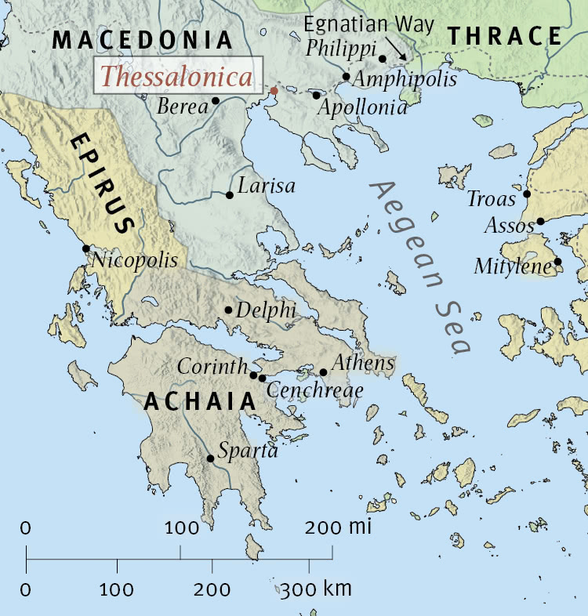
Thessalonica – seaport city

