Slide 1
Honor to whom Honor

Slide 2
“Show me the man you honor and I will know what kind of man you are” – Tho. Carlyle
Honor: value, respect, show high regard for
About 70x in New Testament
Plato: timocracy [timo▪cracy]: government dominated by those who love honor and power or property. Cf. Timo▪thy

Slide 3
1 Pt.2:17, Honor all people. Love the brotherhood. Fear God. Honor the king
1. Fear God
2. Love brotherhood
3-4. Honor all people + honor the king

Slide 4
I. Biblical Uses

Slide 5
Honor
Value, worth: set price on; high regard
1 Co.6:20
Respect
Parents: Mt:15:4
Christians: Ro.12:10
Officials: Ro.13:7
OT: Israel – Saul, 1 Sm.15:30
It is better to deserve honors and not have them than to have them and not deserve them – Mark Twain

Slide 6
I. Biblical Uses
II. Why Should We Honor Christ?

Slide 7
1. Father honors Him
Jn.5:23 (honor: four times)
23 explains 22: just as = same extent; in same manner
16-18: He claims equality with God
19-23: affirmed
Is John deluded? …a fool? …or a true witness?
Son entitled to same honor as Father…
Ph.2:10 ( = Is.45:23, of Father)

Slide 8
2. If we do not honor Christ, we do not honor the Father
Jn.5:23
Fathers are blessed through children
Abraham – Isaac
Pray for sick child…
Father honored Son – 2 Pt.1:…17, For He received from God the Father honor and glory when such a voice came to Him from the Excellent Glory: “This is My beloved Son, in whom I am well pleased”

Slide 9
3. He is our great God and Savior
Tit.2:13, looking for the blessed hope and glorious appearing of our great God and Savior Jesus Christ . . .
Granville Sharp rule
NOT: “the great God and the Savior”
BUT: “the great God and Savior”
Pliny to Trajan: Christians met to sing hymns to Christ as God

Slide 10
4. He is our Creator
Heb.1:2
Inventions bring honor to inventors
Bell South
Ford
Light bulb…
Worlds … God
Hb.3:4, He Who built all things is God

Slide 11
5. His blood paid our ransom
1 Pt.1:19, (redeemed) “with the precious blood of Christ, as of a lamb without blemish and without spot”
“What Can Wash Away My Sins…”

Slide 12
6. He is worthy
Honor to Christ,
Rv.5:8-14
Honor to Father,
Rv.4:9-11
Ph.2⁸ And being found in appearance as a man, He humbled Himself and became obedient to the point of death, even the death of the cross. ⁹ Therefore God also has highly exalted Him and given Him the name which is above every name, ¹⁰ that at the name of Jesus every knee should bow, of those in heaven, and of those on earth, and of those under the earth, ¹¹ and that every tongue should confess that Jesus Christ is Lord, to the glory of God the Father

Slide 13
I. Biblical Uses
II. Why Honor Christ?
III. We Cannot Honor Him By . . .

Slide 14
1. Careless living. David, 2 Sm.12:14
2. Lip service. Mk.7:6. RYR. Balaam
3. Vain worship. Mk.7:7. 1 Sm.2:29
4. Elaborate buildings. Mk.14:58

Slide 15
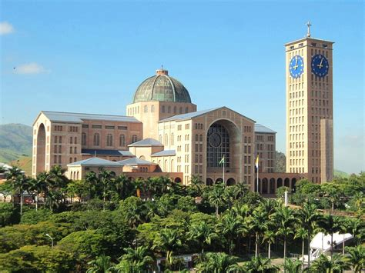
Basilica of National Shrine of Our Lady of Aparecida (Brazil)

Slide 16
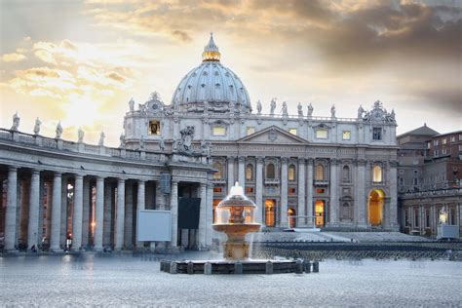
“St. Peter’s” Basilica, Rome

Slide 17
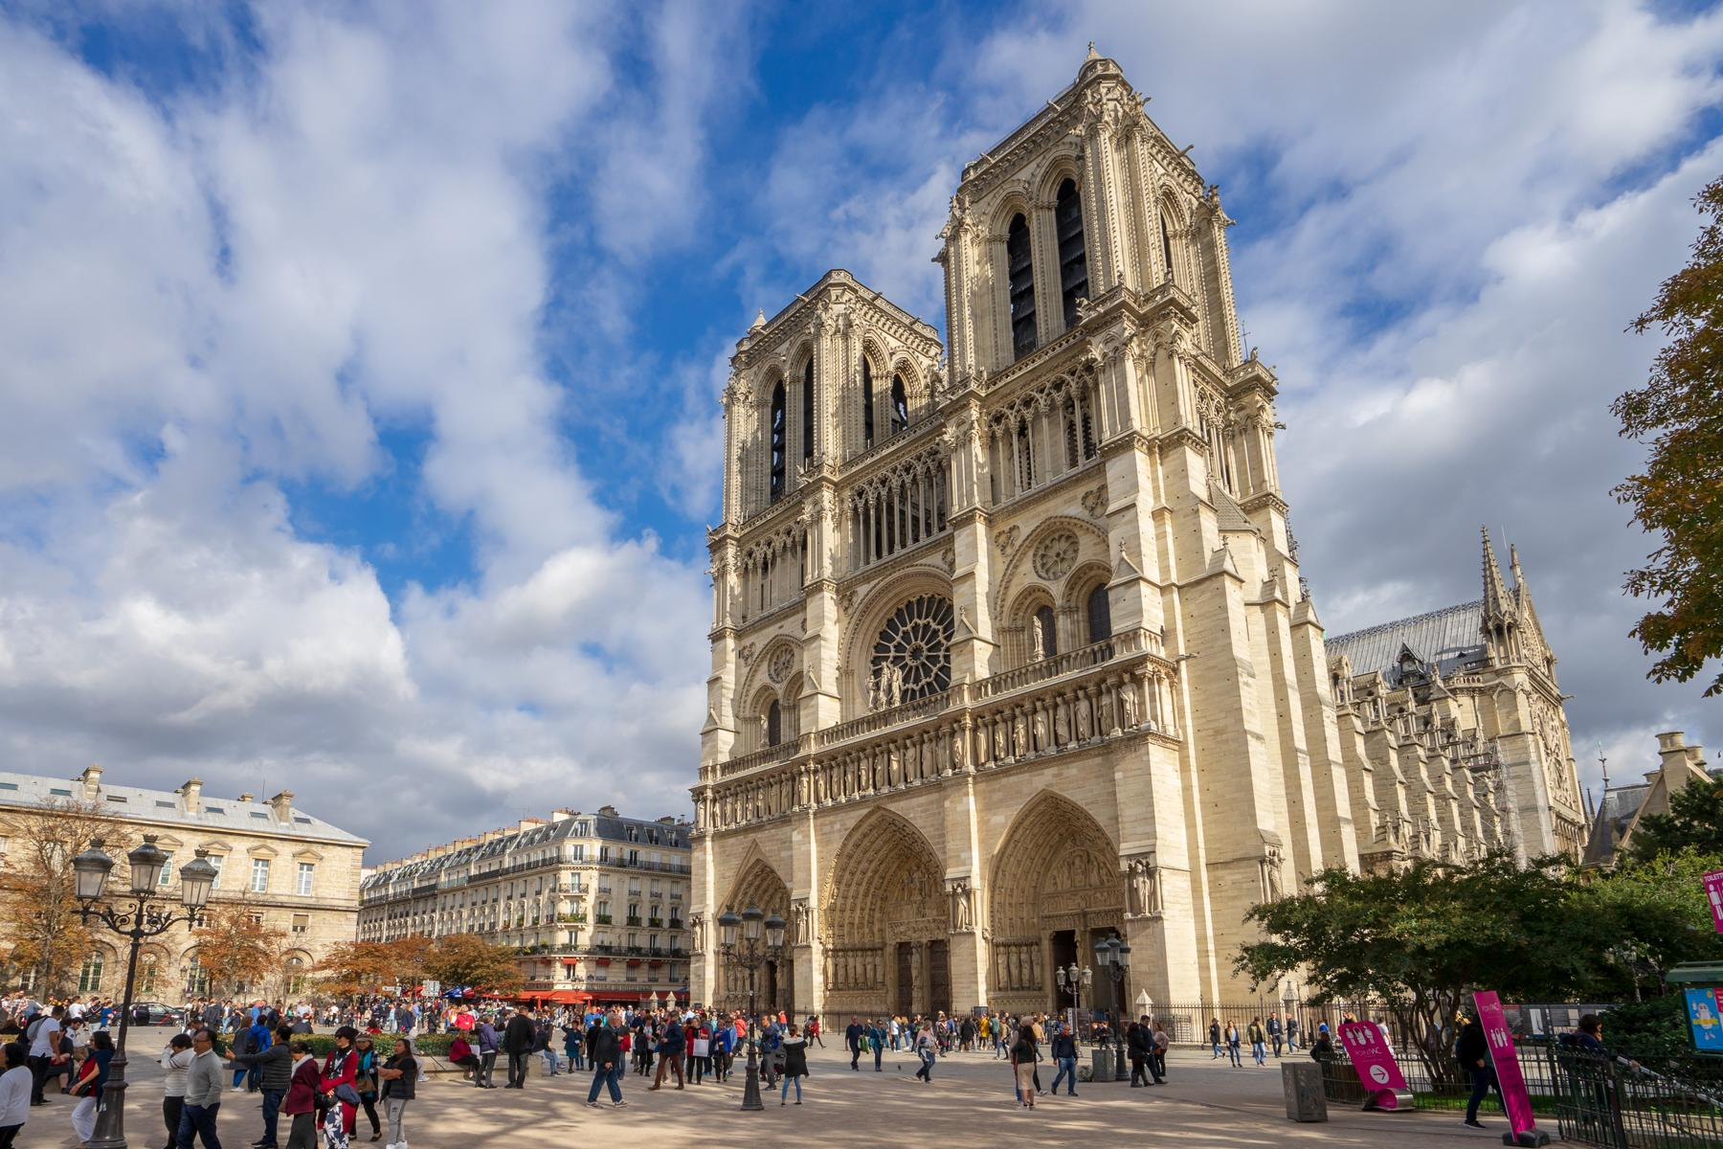
Notre Dame, Paris

Slide 18
We cannot honor Him by . . .
1. Careless living. David, 2 Sm.12:14
2. Lip service. Mk.7:6. RYR. Balaam
3. Vain worship. Mk.7:7. 1 Sm.2:29
4. Elaborate buildings. Mk.14:58
5. Popular members. Lk.9:46 . . . 22:24
6. Large numbers. Ac.2

Slide 19
I. Biblical Uses
II. Why Honor Christ?
III. We Cannot Honor Him By…
IV. How To Honor Christ

Slide 20
1. Obey Him as Lord
Lk.9:51 . . . 19:28-32
1. Full obedience.
2. Costly obedience.
3. Voluntary obedience. Hb.5:8 though He was a Son, yet He learned obedience by the things which He suffered. 9 And having been perfected, He became the author of eternal salvation to all who obey Him

Slide 21
1. Obey Him as Lord 2. Worship Him as God
Lk.19:36
We dishonor Him by . . .
1. honoring men more. Mt.27:20, But the chief priests and elders persuaded the multitudes that they should ask for Barab-bas and destroy Jesus
2. despising men

Slide 22
1. Obey Him as Lord 2. Worship Him as God 3. Serve Him as King
Lk.19:38
Unlike Solomon, He didn’t bring horses from Egypt to bolster His pride.
His tenderness shows in His having the donkey brought with her colt…

Slide 23
1. Obey Him as Lord 2. Worship Him as God 3. Serve Him as King 4. Defend Him as Messiah
Lk.19
³⁹ And some of the Pharisees called to Him from the crowd, “Teacher, rebuke Your disciples.” ⁴⁰ But He answered and said to them, “I tell you that if these should keep silent, the stones would immediately cry out.”
Acts

Slide 24
1. Obey Him as Lord 2. Worship Him as God 3. Serve Him as King 4. Defend Him as Messiah 5. Honor Him with sincerity
1 Pt.3 . . . no one honors Him by . . .
1. Simply owning a Bible (15)
2. Living in worldliness (16)
3. Refusing to stand for truth (17)
4. Compromising truth to avoid persecution (18)
“Christ is not valued at all unless He be valued above all”

