Slide 1
Congregational Independence

Slide 2
Local church
Plurality of saints…
Pool abilities…
Common oversight
NT does not authorize local churches to pool their abilities under a common oversight
There is no organization of local churches
No local church is over another local church

Slide 3
The church is saved people
“So far as we know all brethren have always understood that the individual Christian is the unit of the ‘church universal’”
“The organizational structure of the church begins and ends with the local congregation” – Reuel Lemmons, Editor, Firm Foundation

Slide 4
Local
Comparison
Universal
Rv.2-3
Number
One, Ep.4:4
Ac.5; 1 Co.16
Treasury
Vatican City?
1 Jn.2:19
Salvation
2 Tim. 2:19
1 Co.5; 2-3 Jn.
Discipline
?
Hb.10:24-25
Assemblies
?
Ac.14:23
Overseers
[1 Pt.5:4]
Acts 8
Baptism
1 Co.12:13

Slide 5
I. Three Types of Church Organizations

Slide 6
1. Roman Catholic
Local churches comprise the Church (society that gives blessings of God, preserves the faith)
Ac.20:32, So now, brethren, I commend you to God and to the word of His grace, which is able to build you up and give you an inheritance among all those who are sanctified
Ja.1:21, Therefore lay aside all filthiness and overflow of wickedness, and receive with meek-ness the implanted word, which is able to save your souls

Slide 7
1. Roman Catholic
Local churches comprise the Church (society that gives blessings of God, preserves the faith)
1. They put an institution between Christians and God… (the Lord’s position)
1 Tim.2:5, For there is one God and one Mediator between God and men, the Man Christ Jesus
2. Catholic arrangement calls for universal oversight, action, and treasury
[Parish funds go to Vatican City]

Slide 8
2. Denominational
Episcopal: “The modern Anglican bishop … unlike the elder of the NT has the oversight of a large number of churches in his ‘diocese,’ and exercises authority over the clergy of that area. The elders of the NT are responsible to the chief Shepherd alone, and have a strictly local charge” – ZPEB I, 854
Congregations cannot act collectively and remain independent

Slide 9
3. Independent
NT: Each church does its own work
No church is accountable to another church or organization. Ac.9:…18-25, 26-27
A local church can do its work even if every other church ceases to exist
“The presbyter-bishops appear to have exercised their authority within the sphere of the local congregation, but not beyond it” – ZPEB I, 855

Slide 10
I. Three Types of Church Organizations
II. Practice Does Not Always Match Preaching

Slide 11
Many who plead for Bible pattern do not always practice what they preach
A. Campbell wanted Brush Run Church to join Redstone Association
[Where does NT authorize an association of churches????]
Six years with Mahoning Association (1824)
They dissolved in 1830 to operate independently; A.C. objected

Slide 12
May 1831, A.C. advocated a church made up of local churches
His reasoning…
1. “Must preach gospel to world”
2. “Bible does not tell how”
3. “This requires ¹organization and ²oversight”
* Missionary Society
* 1849, first president – A. Campbell

Slide 13
“Every individual disciple is a particular member of that body (or congregation) with which he is united in Christian communion; and the whole of that community to which he belongs is but a member of that great body which is figuratively called ‘the body of Christ. He is the head of the whole body, or Christian congregation; not merely or specially of one community, but of all the separate communities as constituting one kingdom” – Millennial Harbinger
Makes a Christian a member of a member of body
Pushed collective action of churches – [denomination]

Slide 14
“Now if Christ’s kingdom consists of 10,000 families or churches – particular, distinct, and independent communities – how are they to act in concert, main-tain unity or interests, or cooperate in any system of conservation or enlargement, unless by consultation and systematic cooperation? I affirm it to be, in my humble opinion, and from years of observation and experience impossible – M. Harbinger
[unscriptural]

Slide 15
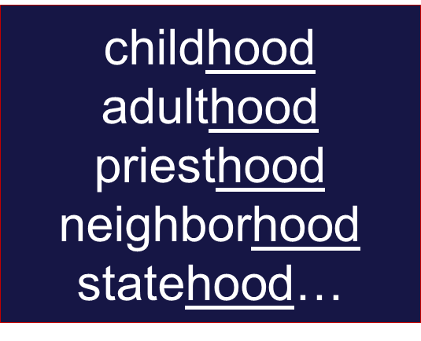
If churches are systematically organized, they are no longer independent
This makes each Christian a member of a member of the body of Christ
This makes each church a unit of the universal church
False beliefs lead to unscriptural practices
Jn.15:5-6. 1 Co.12
1 Pt.2:17, brotherhood
Churchhood???

Slide 16
Some opposed Missionary society
A. Campbell answered: ‘You are objecting to our method.’
1. Go…Teach – church can send preacher / by plane / use powerpoint… (methods)
2. Go…Teach – sponsoring church (methods)
*Each church has its own treasury…
*Contributes to / operates separate treasury…
*Same methods; support different organization
3. Go…Teach – M. Society – preacher / plane / powerpoint…
Problem is not methods, but organization
Only 1. preserves congregational independence
Problem is not methods, but organization
No scripture for 2. or 3. 2 Co.11:7-8

Slide 17
I. Three Types of Church Organizations
II. Peaching Does Not Always Match Practice
III. Does God Want Congregations to Act Independently?

Slide 18
1. Limits scope of each congregation’s treasury. 1 Co.16:1-3 –
Corinth did not control Galatian churches
Members of each flock contributed
Each church chose own messengers, v.3
*2 Co.8:19, 23
*2 Co.11:8, same true in evangelism

Slide 19
1. Limits scope of each congregation’s treasury. 1 Co.16:1-3
*2 Co.11:8, same true in evangelism
“Other churches”: puts treasury on local basis
Each church had own funds; independent
They did not send it to someone else to send to someone else. The money stopped where they sent it

Slide 20
2. Limits scope of each congregation’s oversight
Acts 14:23, each had its own overseers
Ac.20:28, elders limited to one flock
1 Pt.5:1-2, shepherd flock among you (limited scope)
Many denominations have elders over the flock but also join a denominational organization

Slide 21
3. Limits scope of each congregation’s work
1. Each church operates independently of other churches
2. Each church acts as if it is the only church on earth
3. 2 Co.11:8; 1 Th.1:8, no diocese

Slide 22
B.C. Goodpasture (1985 World Book) –
Churches of Christ are…
“a group of religious congregations…”
They support about 200 workers in more than 50 countries
They also operate 4 senior colleges, 10 junior colleges, more than 20 Bible schools, and several orphanages and old-age homes”
The name for group of churches that pool resources to act as one – denomination!

