Slide 1
Qualifications of Elders (IV)
Titus 1

Slide 2
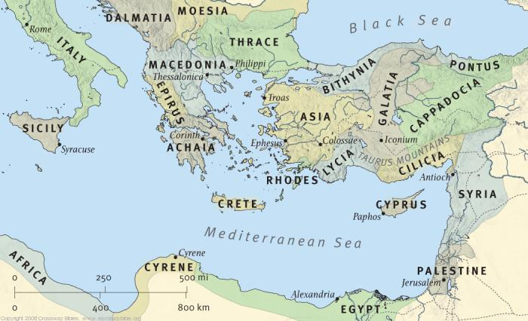
Island of 100 cities – Homer

Slide 3
1. Set in order things that are lacking, 5
Set in order: set right…
Things that are lacking
To be deficient in something that ought to be present (complete)
Tit.3:13, lack nothing
Lk.18:22, one thing you lack
Ja.2:15, in need of daily food
Appoint elders in every city
Ac.14:23, in every church
As I commanded you

Slide 4
2. Having faithful children …6
Faithful: the absolute also means believing (in Christ), a…believer – BDAG
With regard to believers, they are spoken of sometimes in the active sense, sometimes in the passive, i.e., sometimes as believers, sometimes as faithful – Vine
Ac.16:15, faithful to the Lord
2 Co.6:15, what part…believer…unbeliever
Ep.1:1, faithful in Christ Jesus
1 Tim.5:16, believing; 6:2, believing

Slide 5
2. Having faithful children …6
This is not mere faithfulness to parents…
2 Tim.2:2, faithful men … faithful to whom?
Would faithfulness to a father (not to God) demonstrate father’s ability to lead church?
Gn.18:19
Goal of godly parents: Ep.6:4 – discipline, instruction of Lord
2 Tim.1:5, genuine faith
2 Tim.3:15, wise for salvation through faith…
Tit.1:6, faithful children

Slide 6
2. Having faithful children …6
“What if a child is ‘faithful’ at home but falls away after leaving home?”
How to prove qualification applies to children at home, but not after they leave?
1 Tim.3:4, well
Tit.1:6, faithful
A man’s family training demonstrates his ability to lead others into strong faith

Slide 7
2. Having faithful children …6
1 Tim.3:4-5, different words, same conclusion
Rules own house well. 1 Tim.5:17
Exercise position of leadership, direct, be at the head (of)
Does he enforce obedience without training in way of Lord?
Having his children in submission
With all reverence: behavior that indicates what is above what is ordinary and therefore worthy of special respect. Seriousness, holiness – BDAG

Slide 8
2. Having faithful children …6
For if a man does not know how to rule his own house, how … care of church of God?
1 Tim.3:4-5, take care of –
The ‘rule’ of 1 Tim.3:5 is the ‘rule’ of v.4
‘Care’ – Lk.10:34-35 (to save a life) . . .
1 Tim.3:5, same diligence to save souls

Slide 9
2. Having faithful children …6
“Not only does the [overseer] watch over and busy himself with the community, but he also sees to its spiritual needs and devotes all his energy to it” – Spicq, II, 51f.

Slide 10
2. Having faithful children …6
“There is an analogy between caring for an ordinary household and caring for the household of God, which makes a working knowledge of the former a condition for success at the latter, and implies that the same qualities are required in both spheres” – Marshall

Slide 11
2. Having faithful children …6
Do we expect elder’s child to sit quietly in assembly, causing no disturbance . . . but not paying attention…?
The rule of 1 Tim.3:5 is the rule of 1 Tim. 3:4
Elder’s house (1 Tim.3:5) prepares him for Lord’s house (1 Tim.3:15)
What if a child receives little or no discipline? 1 Sm.3:13

Slide 12
2. Having faithful children …6
Tit.1:7, overseer: a man charged with the duty of seeing that things to be done by others are done rightly, curator, guardian, or superintendent – Th.
Tit.1:7, steward: the responsibility of safe-guarding or seeing to it that something is done in correct way, guardian
Joseph over Potiphar’s house
Elders carry out Lord’s laws, not their own

Slide 13
2. Having faithful children …6
1 Pt.5:2-3, not lords…
1. Lording over implies possession of authority
2. He rules; he does not abuse his power
Mt.20:25 . . . Mk.10:42
Not even apostles were allowed to ‘lord it over’ a congregation

Slide 14
2. Having faithful children …6
“Does ‘children’ require an elder to have more than one child?”
1. Gn.21:7, plural includes singular
2. Mt.22:24, having ‘no children’
3. Mk.12:19, ‘no child’ (ASV; NASV; ESV; ISV; NRSV)
4. Ac.2:37, promise
5. 1 Tim.5:4, if one child, not qualified…?

Slide 15
3. Not a novice, 1 Tim.3:6
ESV: recent convert, , NASV: new convert
Newly planted
Danger: puffed up with conceit
Fall into condemnation of devil (condemn-nation incurred by the devil, NASV)
Pride is great disaster for congregation and novice

Slide 16
4. Good testimony among those who are outside, 1 Tim.3:7
ESV: well thought of by outsiders.
NASV: good reputation with those outside.
Confirmation or attestation on the basis of personal knowledge or belief.
Attestation of character / behavior – BDAG

Slide 17
4. Good testimony among those who are outside, 1 Tim.3:7
Fall into reproach and snare of devil
Weak spots will come to light
Dn.6
Reputation of church depends largely on its leaders. 1 Tim.5:19-21

Slide 18
5. Self-willed, Tit.1:7
ESV: arrogant
Stubborn, arrogant. One who pleases himself. Overvalues his own rights, reckless with others.
Opposite of Mt.16:24

Slide 19
6. Not quick-tempered, Tit.1:7
Inclined / prone to anger
As an elder, his patience will be tried often
If he is a hothead…
Ep.4:26, Be angry, and do not sin: do not let the sun go down on your wrath, 27 nor give place to the devil. [it can be controlled]

Slide 20
7. Lover of what is good, Tit.1:8
Loving what is good (NASV)
Whether ‘good things’ or ‘good persons’ is not clear, but probably it ought to be taken in its widest meaning, as including both – Bernard
2 Tim.3:3, despisers of good

Slide 21
8. Just, Tit.1:8
ESV: holy
Fair, upright, makes decisions free from partiality
Mt.1:19, Then Joseph her husband, being a just man, and not wanting to make her a public example, was minded to put her away secretly

Slide 22
9. Holy, Tit.1:8
Devout, pious, self-controlled; self-mastery
Undefiled by sin, free from wickedness, religiously observing every moral obligation, pure, holy, pious – Th.
1 Tim.2:8

Slide 23
10. Self-controlled, Tit.1:8
Disciplined; devout. Having one’s emotions, impulses, or desires under control
Having power over; mastering, controlling, curbing, restraining – Th
1 Co.9:27, must master self before he can help others

Slide 24
11. Holding fast the faithful word… Tit.1:9
Have a strong attachment to someone or someth., cling to, hold fast to, be devoted to – BDAG
Everyone holds fast to something. Mt.6:24
Able to exhort in sound doctrine – encourage, instruct, urge strongly
Able to convict – refute, rebuke, those who contradict (10-11)
‘It means to prove that things cannot be otherwise than as we have stated them’ – Aristotle

