Slide 2
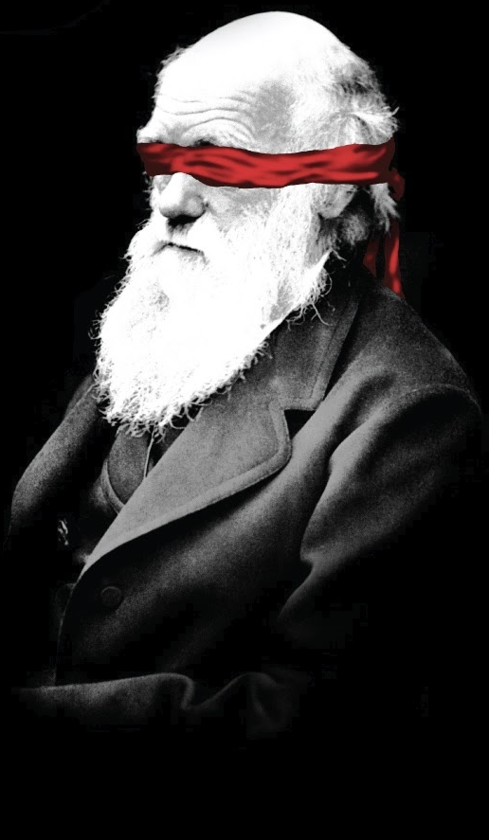
Do So Many
People Believe
In Evolution?

Slide 4
Once upon a time, a man left home jogging. He jogged a little ways and turned left. He jogged a little ways and turned left. He jogged a little ways, turned left and jogged back home.
As he was jogging home, he noticed two masked men waiting for him at home.
Who were the masked men?
Why did he leave home jogging?

Slide 5
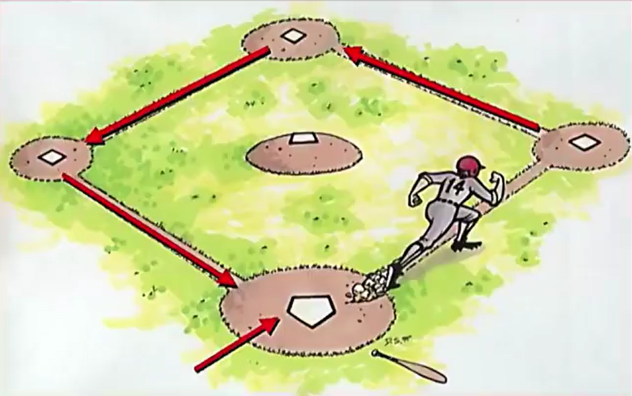
Once upon a time, a man left home jogging….

Slide 6
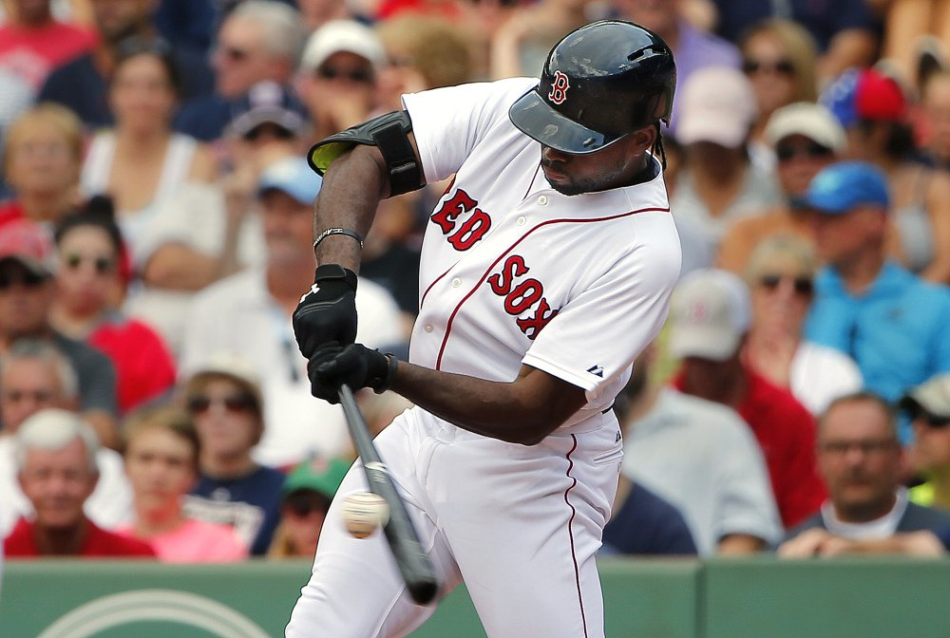
Who were the masked men?
Why did he leave home?

Slide 7
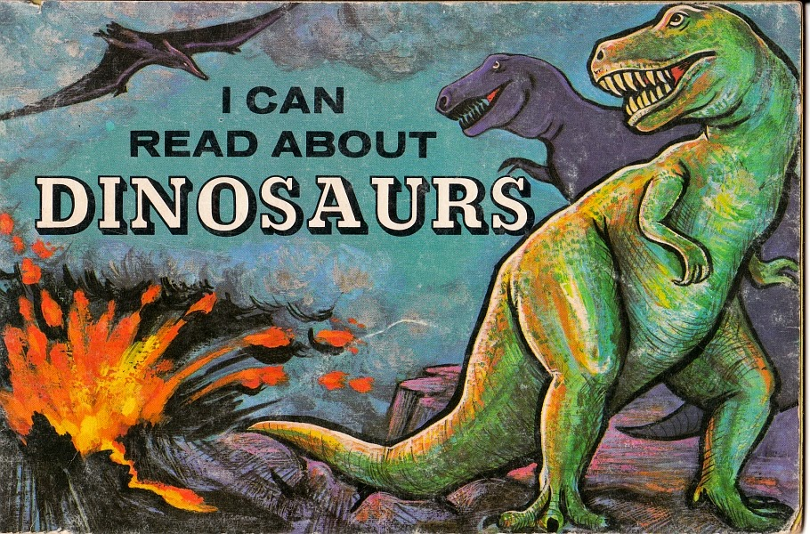
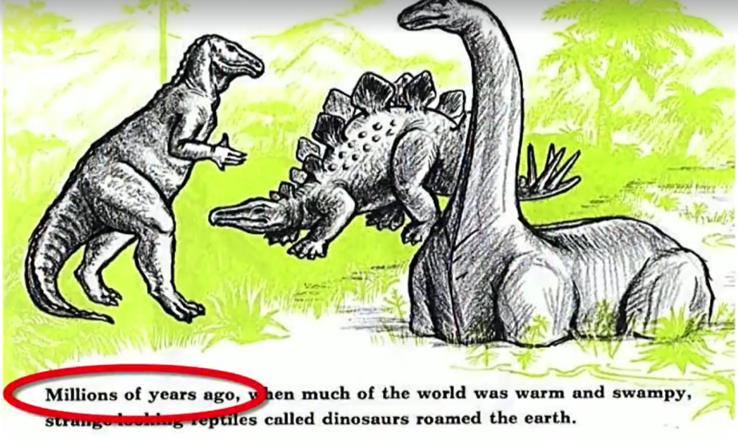
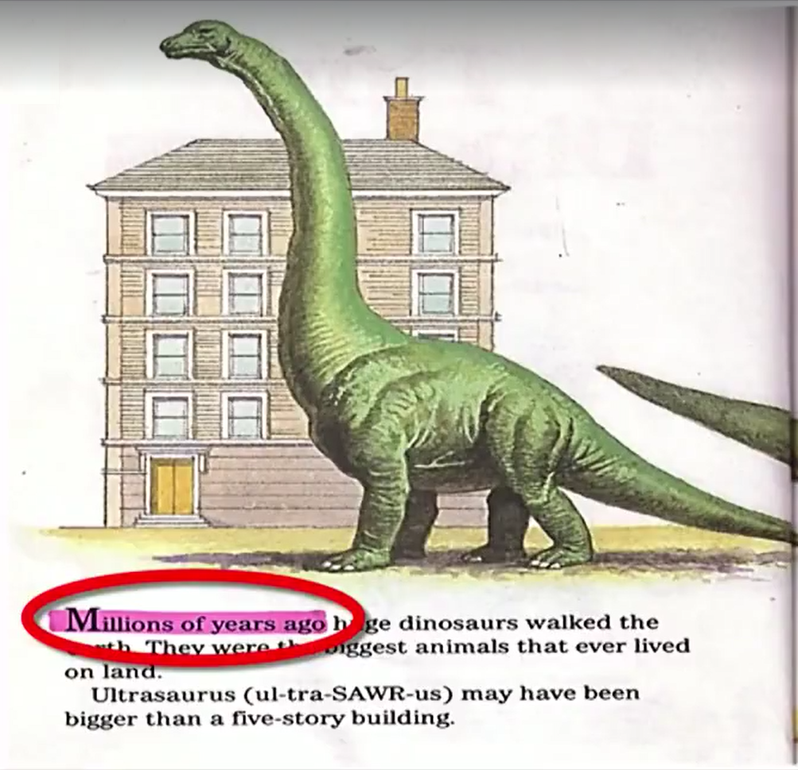
Brainwashing

Slide 8
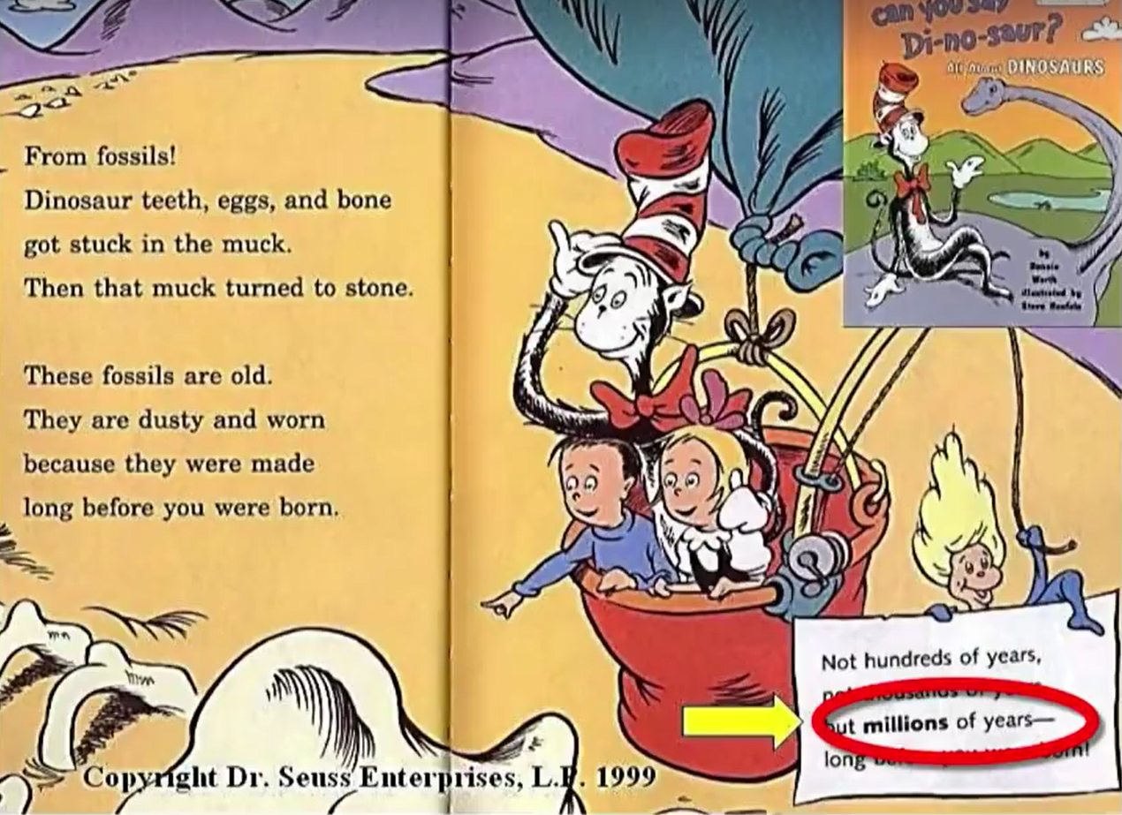
Brainwashing

Slide 9
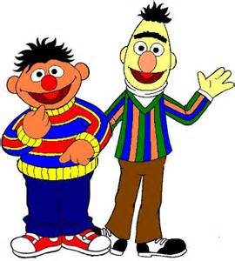
Brainwashing

Slide 10
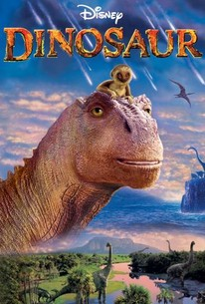
Brainwashing
2 Cor 11:14-15 – “…Satan disguises himself as an angel of light. Therefore it is not surprising if his servants also disguise themselves as servants of righteousness, whose end will be according to their deeds.”

Slide 11
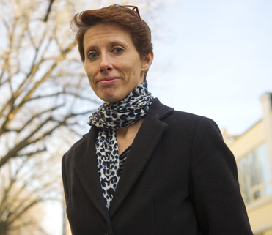
Brainwashing
Deborah Kelemen – “…capitalizing on young children’s drive for coherent explanation, factual knowledge, and interest in trait function, along with their affinity for picture storybooks, is a viable initial step toward overcoming conceptual pitfalls that can undermine later learning about adaptation.”
“…children in early elementary school can be taught the basic logic of adaptation by natural selection via a brief but comprehensive storybook intervention…the intervention resulted in approximately 40-fold increases in children’s odds of increasing their factual and theoretical understanding.” (Young Children Can Be Taught Basic Natural Selection Using a Picture-Storybook Intervention, 2014, Psychological Science. 25(4): 893–902)

Slide 12
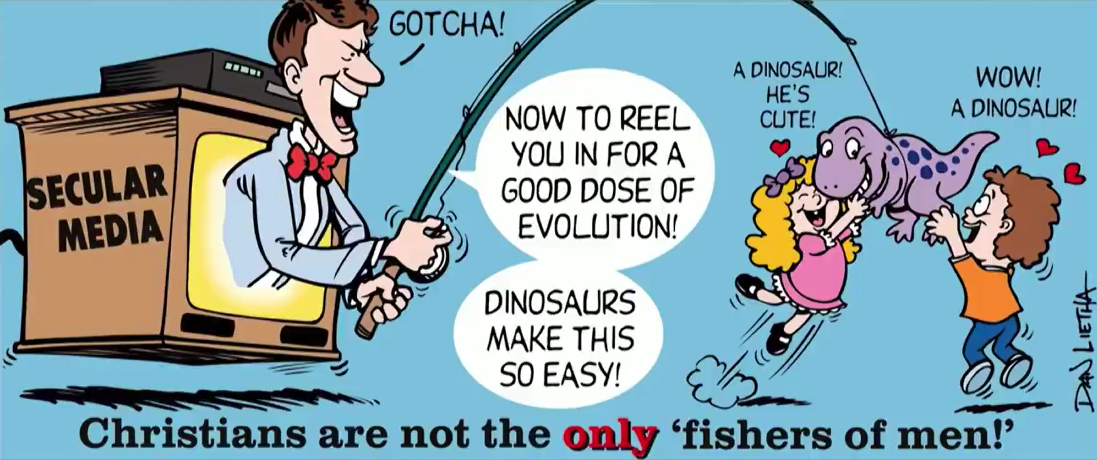
Brainwashing

Slide 13
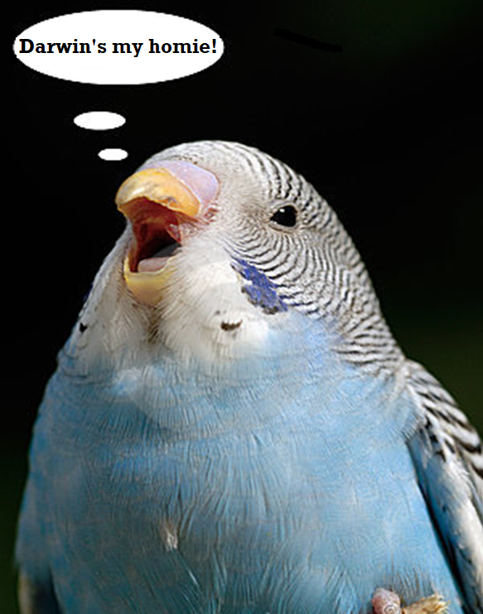
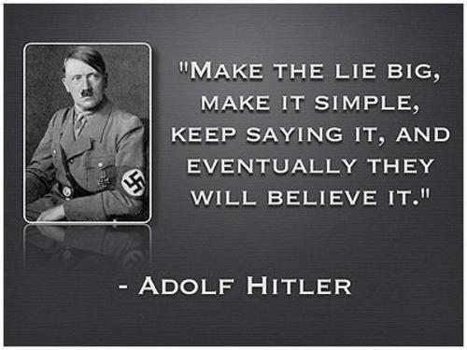
Brainwashing
John Scopes – “…if you limit a teacher to only one side of anything the whole country will eventually have only one thought, be one individual. I believe in teaching every aspect of every problem or theory.” (Scopes Trial, “The World of Biology”, p.610

Slide 14
Brainwashing
Prov 18:17 – “The first to plead his case seems right, until another comes and examines him.”
Prov 18:13 – “He who gives an answer before he hears, it is folly and shame to him.”

Slide 15
Questions For Evolutionists
“Have you ever considered the evidence for Creationism?”
“Did you know that not all scientists believe in macroevolution, including some of the most famous scientists that have ever lived?”

Slide 16
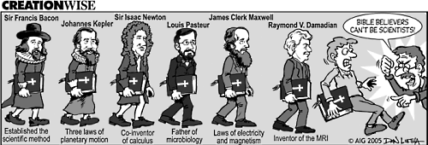
Intimidation
Sun revolves around the Earth (1600)
Fire is caused by “phlogiston” (1750)
Sick people treated by bleeding them (1800)
Inheritance transmitted by gemules (1859)
Women & African races inferior to white men (1860)
Lobotomies performed to treat the mentally ill (1940)
“Steady State Theory” replaced w/“Big Bang Theory” (1960)
Autism caused by childhood vaccines (retracted in 2010)

Slide 17
Intimidation
“Scientists have discovered that people will believe anything when you claim scientists have discovered it."

Slide 18
Intimidation
Scientific Method
Macroevolution
Observation
Observation
Hypothesis
Hypothesis
Experiment
Experiment
Repeatable
Repeatable
Falsifiable
Falsifiable

Slide 19
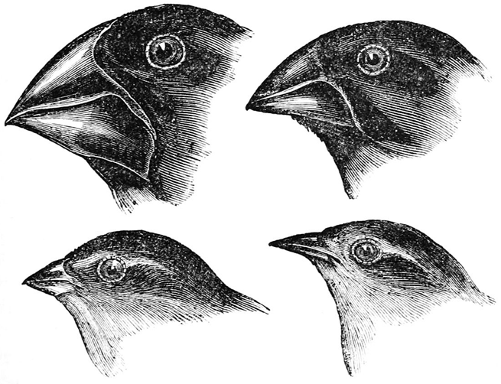
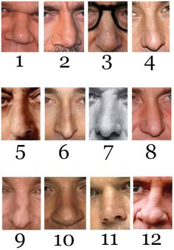
Intimidation

Slide 20
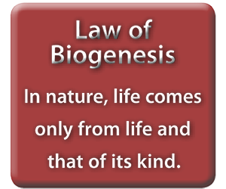
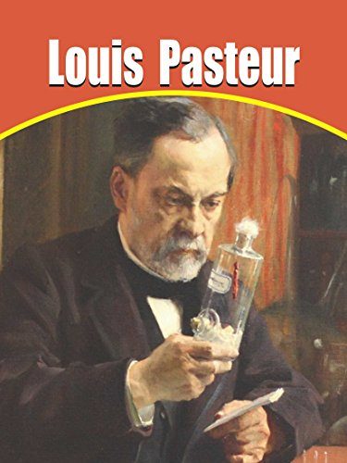
Intimidation

Slide 21
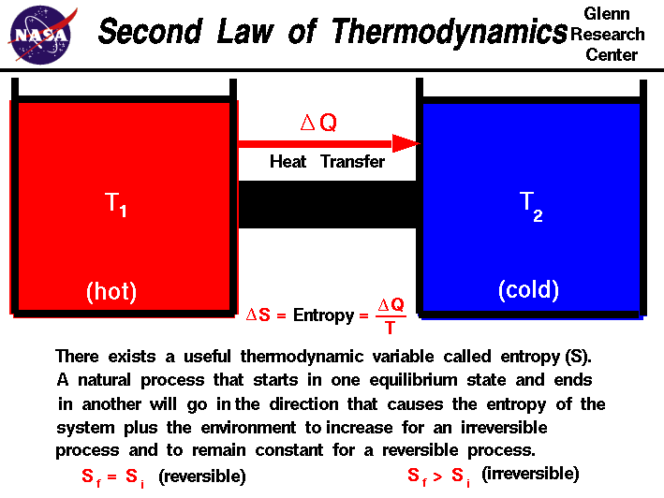
Intimidation

Slide 24
Questions For Evolutionists
“Have you ever considered the evidence for Creationism?”
“Did you know that not all scientists believe in macroevolution, including some of the most famous scientists that have ever lived?”
“Can you give just one, observable example of nonlife creating life?”
“Can you name one example of an observable beneficial mutation that changes one species into another?”
“Can you give me an example of just one fossil that represents an actual, missing link between species?”

Slide 25
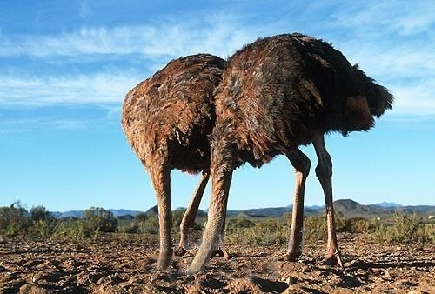
Escape Accountability
Richard Dawkins – “Darwin made it possible to be an intellectually fulfilled atheist” (The Blind Watchmaker, New York: W.W. Norton, 1986, p. 6).
Clarence Darrow - “I do not believe there is any sort of distinction between the real moral conditions of the people in and out of jail. One is just as good as the other. The people here can no more help being here than the people outside can avoid being outside. I do not believe that people are in jail because they deserve to be. They are in jail simply because they cannot avoid it on account of circumstances which are entirely beyond their control and for which they are in no way responsible.” (Arthur Weinberg, Attorney For The Damned, New York: Simon & Schuster, 1957, pp. 3-4; emp. WJ).

Slide 26
Escape Accountability
Jeremy Rifkin – “We no longer feel ourselves to be guests in someone else’s home and therefore obliged to make our behavior conform with a set of preexisting cosmic rules. It is our creation now. We make the rules. We establish the parameters of reality. We create the world, and because we do, we no longer feel beholden to outside forces. We no longer have to justify our behavior, for we are now the architects of the universe. We are responsible to nothing outside ourselves, for we are the kingdom, the power, and the glory forever and ever.” (Algeny, p. 244, Viking Press, New York, 1983)

Slide 28
Questions For Evolutionists
“Have you ever considered the evidence for Creationism?”
“Did you know that not all scientists believe in macroevolution, including some of the most famous scientists that have ever lived?”
“Can you give just one, observable example of nonlife creating life?”
“Can you name one example of an observable beneficial mutation that changes one species into another?”
“Can you give me an example of just one fossil that represents an actual, missing link between species?”
Can I introduce you to Jesus Christ?

Slide 29
