Slide 1
Baffled About Baptism

Slide 2
NT written in common language
1. Acts 2⁴⁴ Now all who believed were together, and had all things in common . . .
2. Some passages are difficult: 2 Pt.3¹⁶ as also in all his epistles, speaking in them of these things, in which are some things hard to under-stand, which untaught and unstable people twist to their own destruction, as they do also the rest of the Scriptures

Slide 3
Hebrews 5¹² For though by this time you ought to be teachers, you need someone to teach you again the first principles [elements of the beginning] of the oracles of God; and you have come to need milk and not solid food. ¹³ For everyone who partakes only of milk is unskilled in the word of righteousness, for he is a babe. ¹⁴ But solid food belongs to those who are of full age, that is, those who by reason of use have their senses exercised to discern both good and evil
Hebrews 6¹ Therefore, leaving the discussion of the elementary principles [word of the beginning] of Christ, let us go on to perfection . . .

Slide 4
Hb.6:1, elementary principles (NKJV)
Basic teaching (NRSV)
Elementary doctrine (ESV)
Elementary teaching (NASB)
Hb.6:1, grow! (Leave elementary principles)
Accountable people have no excuse for ignorance; some prefer ‘another way’

Slide 5
I. Heeding The Scriptures, Ac.8

Slide 6
Ac.8:26-27
26: Angel sent preacher (Philip) . . . [not direct operation of an angel]
27: ‘a man’ from Ethiopia, had worshipped in Jerusalem [already religious; not saved. Cf. Ac.2]
26: Gaza (city), Hebrew (strong, fortified)
27: Gaza, Persian word (treasure)

Slide 7
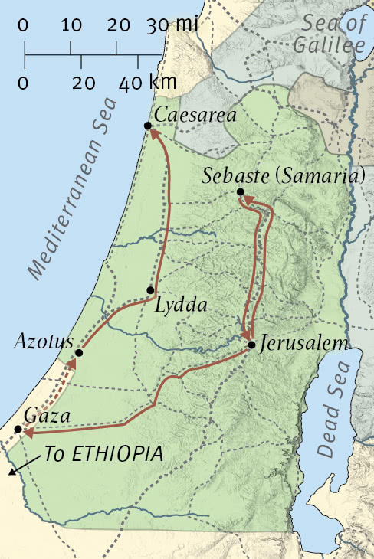
Ac.8:26-27

Slide 8
Ac.8:26-28
26: Angel sent preacher . . . [not direct operation of an angel]
27: ‘a man’ from Ethiopia, had worshipped in Jerusalem [already religious; not saved. Cf. Ac.2]
28: ‘reading Isaiah’ [aloud, 30]
26: Gaza, Hebrew (city) . . .
27: Gaza, Persian word (treasure)

Slide 9
Ac.8:27-28, hungry for more…
The man was . . .
Religious
Zealous
Sincere
Respected
Trusted
Proselyte (?)
Ignorant of gospel
Lost
1. If universalism is true, why bother?
2. Religious people in Ac.2, 3, 9, 10, but lost
3. Zealous people (Ac.2 = Ac.8)

Slide 10
29: Spirit connects preacher with sinner
30: Philip’s questions show him where to begin
31: Guide me… (admits need for help)
Wrong guide → wrong destination
Philip: God’s guide
Ro.2¹⁹ confident that you yourself are a guide to the blind, a light to those who are in darkness, ²⁰ an instructor of the foolish, a teacher of babes, having the form of knowledge and truth in the law. ²¹ You, therefore, who teach another, do you not teach yourself

Slide 11
Understanding is Essential
32-34: As most Jews, eunuch does not under-stand Jesus … especially His sacrificial death
35: Philip explains “Jesus” with O.T.
Jesus fulfills Isaiah 53 – (Ac.8:32-33) – a concept lost to Jews in their own Scriptures
Philip (Acts 8)
1. Explains text – what?
2. Applies text to reader – so what?
3. Training – who else?

Slide 12
36: water baptism? ?
“I thought Philip was preaching JESUS” (35)
Preaching Jesus includes His gospel
Philip’s response = Ac.2:40 (same as preaching of Acts 2)
Eunuch’s response = Ac.2:41 (those who received the word…)

Slide 13
37-39: when does the eunuch rejoice? ?
Four facts –
1. Lord’s preachers taught same thing every-where. Cf. 1 Co.4:17
2. Preaching Jesus includes preaching baptism. Contrast denominations.
3. Baptism requires going to, getting into water to immerse…
4. Plan is simple: eunuch understood it the first time he heard. Cf. –
*Jerusalem, Ac.2:37-41 . . .
*Samaria, Ac.8:5-13. Certainty is wonderful

Slide 14
40: Philip left the eunuch to find others
Resembles another time when a Stranger . . .
¹ joined two travelers
² explained Scriptures to them
³ took part in a meal
⁴ then disappeared
Luke 24: 13-35

Slide 15
I. Heeding The Scriptures, Ac.8
II. Hindrances To Salvation, Ac.8³⁶

Slide 16
1. Doubters deceive and are deceived about baptism
1. ‘Salvation by water’
2 K.5, Naaman: does anyone believe water cured leprosy?
Jn.9:1-7, blind man … water?
1 Pt.3:20-21, not mere water but proper use of water is NT condition for salvation

Slide 17
1. Doubters deceive and are deceived about baptism
2. ‘Salvation by works’
2 K.5, Naaman glorified God, not his own work
Jn.9:1-7, blind man gave glory to Christ, not himself

Slide 18
1. Doubters deceive and are deceived about baptism
3. ‘Salvation by faith’
2 K.5, required faith (obedience)
Jn.9:1-7, required faith (obedience)
Faith includes baptism. Gal.3²⁶ For you are all sons of God through faith in Christ Jesus. ²⁷ For as many of you as were baptized into Christ have put on Christ.

Slide 19
1. Doubters deceive and are deceived about baptism
4. ‘Salvation by grace’
What if:
‘Naaman saved by grace; dipping not necessary’? ?
‘Blind man cured by grace; washing not necessary?’ ?
Or: ‘saved by grace, not faith’? ?
False choices offer: either - or
NT teaching requires: both - and

Slide 20
2. Deniers of consequences of baptism
Rom.6:3-4
In baptism, one enters into Christ…rises to walk in newness of life
New life requires some things, forbids others. This hinders some who don’t want to change their –
Minds: “I always believed this way…” – Cf. Jew, Acts 2
Ways: “I’m set in my ways…” Repentance is the hurdle.

Slide 21
3. Delayers of baptism
Acts 24:24-25
“Tomorrow” – the great thief of souls
Felix –
1. Desire to hear
2. Willing to listen
3. Know the truth
4. Agree with gospel
5. Fear for soul
6. Plan to obey
Tomorrow – too little, too late

Slide 22
4. Dodgers ignore passages on baptism
Mk.16:15-16, he … shall be saved. He who?
All ... (universalism?)
Believer ... w/o baptism? Faith alone? (Ja.2)
Baptized w/o belief? (Catholicism – infants)
Baptized believers?

Slide 23
4. Dodgers ignore passages on baptism
Ac.2:37-38, repent … be baptized…
Joins two conditions: ¹repent + ²be baptized
Whatever repentance is for, baptism is for

Slide 24
4. Dodgers ignore passages on baptism
Ac.22:16, Saul
Not saved on road
Not saved by prayers
Not saved by fasting
When?
Belief and repentance did not wash his sins away without baptism
10: would be told what to do. 16: what?

Slide 25
4. Dodgers ignore passages on baptism
1 Pt.3:21, baptism and salvation
Parallels Mk.16:16 without reference to ‘faith’
20: type: destroyed evil world; eight saved in new world
21: antitype: baptism corresponds to this
Destroys old man, saves us
Who saves … “by resurrection of Jesus Christ”? – When?

Slide 26
“I was baptized. If that’s what it takes, I’m in!”
People are always baptized in something for something. Does purpose matter?
Mt.6:1, Pharisees: good practice cancelled by wrong purpose
1 Co.11:20, ate right elements … but did not partake of Lord’s Supper
Ac.19:1-7, right subjects / element / action / wrong purpose
“Why” matters. You have one soul…
2 Pt.1:10

